Slide 1
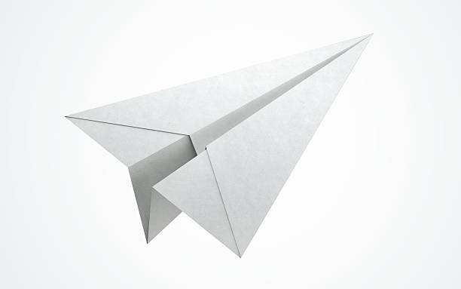
Paper Airplanes
Notes:
Grab a piece of paper. Take 3 minutes to create your best airplane.
Take a minute to go fly it. Measure – best guess, use your feet to estimate, come back and report, show us your plane

Slide 2
Invisible (Learned/Assumed) Constraints
Participants rarely….
Use materials other than those provided
Reference the internet for optimal designs
Test and refine a prototype
Stand at a higher elevation to provide a better point of take off
Work as a team (or seek outside advice)
Stretch the definition of an “airplane”
Can anyone guess the “design” that usually wins?

