Slide 1
Design Sprint TEMPLATE
Notes:
Felicia – Greeting
Self-intros

Slide 2
In-School Applicability
Deciding when/where to stop
Don’t skip the ‘understand phase’.
We often stop after the converge phase for presentations.
Broad applicability and use
Design sprints work well with topics/challenges that are:
Real, urgent, meaningful
Have no clear/right answer
In need of creative problem solving
Open ended but not too open

Slide 3
Examples of Implementation
School leadership team using a 2-3 week sprint focused on adapting staff hiring/onboarding/retention processes to increase the innovative capacity of faculty
Full teaching staff during a 90 min staff meeting focused on accreditation review strategic initiatives
Students in a 60 min civics class focused on decreasing environmental impact of school lunch

Slide 4
Facilitation Notes
Timing
60 min minimum for work time will be needed
Keep a timer running and visible at least for yourself, it can be helpful to add time above what was stated if the conversation and creativity are flowing
Convergent thinking is often the most variable for groups. Typically give more time for this than divergent thinking or understanding the problem. For groups who arrive at one solution quickly, have them begin developing how they will present the solution or building a prototype.

Slide 5
Facilitation Notes
Participants
Recommend groups of 3-5 people
It’s challenging to both lead and participate in a sprint. If you want to be an active voice in the problem solving, consider a third party facilitator.
Be mindful of group dynamics. Having diverse perspectives in a group is important, but you will need to create a space that all voices and ideas will be heard and valued.

Slide 6
Facilitation Notes
Tangible Tools
Sticky notes are highly encouraged. Having the tangible representation of individual ideas helps.
Google Jamboard or Mural (free for educators) are online collaboration tools where this can be done
Impact vs Feasibility matrix – if using these criteria, have participants draw a matrix or have one preprinted.
Camera – take a photo of final matrix or be sure ideas not chosen are captured as these often become helpful to look back on in the future.

Slide 7
Facilitation Notes
Exercise Tools
Solo flight
Specific time for silence and individual thought before group share outs.
Take 2
Each group member shares their ideas or thoughts for ‘2’ minutes. You can choose any number here. This ensures all group members have equal voice time which helps to limit the loud and encourage the quiet.
Dot voting
With many ideas on the table or potential solutions, each person is given three dot stickers and an opportunity to vote for the best idea from their perspective. This might be followed by a ‘take 2’ for people to explain their votes. This can help with consensus building but generally consensus doesn’t always equal the best idea. Ensure there is discussion before selecting a move forward solution.

Slide 8
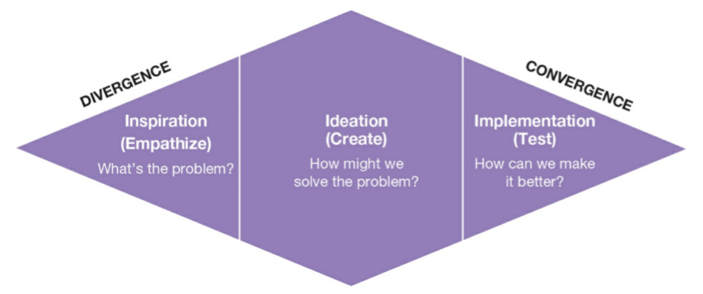
Design Sprint

Slide 9
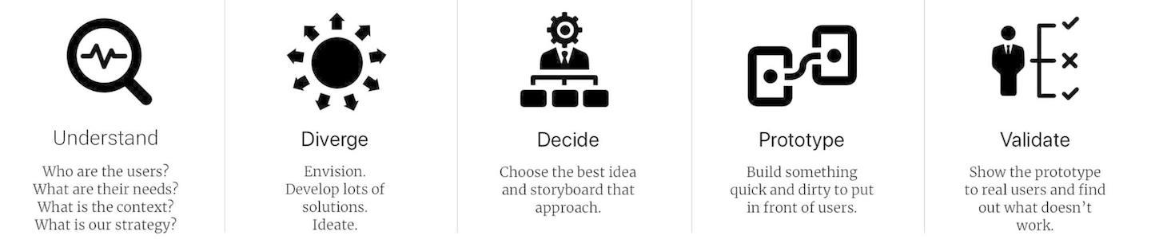
Today’s Topic
PROBLEM
Notes:
Insert the problem in need of creative problem solving here. Don’t ask a ‘how might we’ question yet.

Slide 10
Step 1: Understand the Problem
Explore various facets of the problem: Who are the users? What are their needs? What’s the context? What are the goals? What’s the strategy? Why does it matter?
(Ideally) Include primary research – discuss with target group to gain full understanding – and secondary research
Concludes with a well defined problem statement – a question that can be used to prompt divergent thinking (for example, How can we...?”)
Notes:
Best to give a set amount of time for digging into the problem and then a few minutes toward the end to encourage groups to ensure they write a problem statement.

Slide 11
Step 2: Diverge
Generate a list of as many possible solutions as possible
4 Rules for Brainstorming
Go for quantity, not quality
Defer judgment
Build off the ideas of others
Go for crazy ideas
Notes:
Remind participants that judgement can be verbal or expressed through body language and facial reactions. Judgement also happens in our own heads and we need to be mindful to letting idea flow good, bad, or anything in between.

Slide 12
Brainwriting
An idea generation technique where participants write down their ideas about for a few minutes without talking resulting in a broader range of ideas that may not have surfaced during a collective out-loud session.
Notes:
Provide solo time and ask individuals to write one idea per sticky note. NOTE: Utilizing quiet solo time helps to ensure individuals who may be more introverted also have their ideas represented

Slide 13
Reverse Brainstorming
Instead of generating solutions, generate ideas of how to cause problems in this area or make it worse.
Notes:
This can help unlock some stuck-ness to help creativity to flow. Another option here is asking participants to come up with a few ideas that would be illegal.
With limited time, this may be skipped.

Slide 14
Traditional Brainstorming
Out loud idea generation of new ideas, combining or adapting already produced ideas
Notes:
Typically this is done in groups of 3-5 people. Recommend each individual sharing all of their stickies. Groups can continue to add more stickies or begin to group commonalities.
“What’s missing from the idea board?”
It may be helpful to encourage people to look at their problem statement or prompting question and consider if all facets of the problems have had ideation.

Slide 15
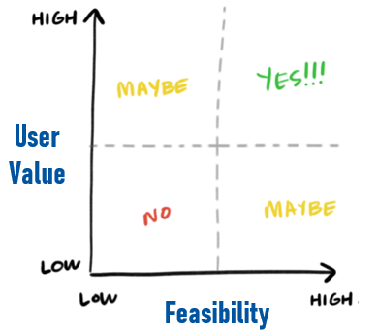
Step 3: Converge & Decide
Narrowing down the possibilities using established criteria to identify the most promising options worth of pursuing.
Today’s Criteria:
Feasibility – How ‘easy’ will it be to achieve success? How much time, effort, money and other resources will be required?
Impact – If the action is successful, how much value will be created? What consequential benefits/improvements will be realized?
Impact
Feasibility
Notes:
You may choose other criteria – there may be a budget or timing constraint that will need to be considered. If there are multiple criteria, it may be helpful to put it into a chart and include a weight relative to the importance of the criteria.

Slide 16
Step 4: Prototype
Create a quick tangible deliverable (mockup, physical product, etc)
Share with experts/users to gather feedback
Iterate and refine based on feedback
Repeat as necessary

Slide 17
Step 5: Validate
Real world implementation and testing
Continue to seeking user feedback and iterate

