Slide 1
EntreX Professional Development
Felicia Harrington
August 2025
Grab a nametag and answer the 4 questions on the far wall!
Notes:
Introductions, why
Objective for the day: experience (hear about basketball, watch basketball, get on the court – what’s the best setup to coach it)
Learn from experience – amazing network of people, diversity of backgrounds and experiences, chance to get to know each other a bit, returning teachers
Goal is to leave you excited to teach the course, grounded in basics of both the style and the curriculum, and well aware of the resources and support available – all of which ensuring you’re on a stead foundation to launch the program at your school

Slide 2
Who’s in the room?
Share your name, school/location, and the title or topic of a podcast you’d host just for fun.
  What would you talk about every week—something you’re a total enthusiast or pseudo-expert in—even if it had a niche (or nonexistent) audience and zero rules?

Slide 3
EntreX Expectations
What to expect from us
  Passion for the work
  Communication – transparent and timely
  Willingness to learn and improve
  Support your challenges, Celebrate your successes
What we expect from you
  Willingness to learn and improve
  Communication – transparent and timely
  Openness to sharing so others can learn
  Share your challenges, Share your successes

Slide 4
What to expect from PD?
Morning
  Student Mindsets: Overcoming Hidden Constraints, Unlocking Creative Potential
  Lived Experience and Perspective: Returning Educators Discussion
Afternoon
  Tangible Tools: Design Sprints, Quick Creative Openers
  Need to Knows: Getting to Day 1 and Beyond

Slide 5
Detailed Agenda for Today
9:30am Overcoming Your Students’ Invisible Barriers
10:20am BREAK
10:30am Unlocking the Creative Potential of Your Students
11:00am Returning Educator Panel Discussion
12:00pm LUNCH
12:50pm Love it!
1:05pm Design Sprint
2:10 pm Design Sprint Facilitation
2:30pm BREAK
2:40pm Resources and Canvas
2:55pm What is it?
3:05pm Consider the Calendar
3:25pm Questions/AMA
3:50pm Reflection and Wrap Up
Notes:
Share objective for the day – experiencing activities
Often we’ll do the activity, then take some time to discuss facilitation notes or why behind/goals of activity
Also chance to ask questions and some and ensure you’re set for school to start

Slide 6
Overcoming Students’ Invisible Barriers

Slide 7

Paper Airplanes
Notes:
Grab a piece of paper. Take 3 minutes to create your best airplane.
Take a minute to go fly it. Measure – best guess, use your feet to estimate, come back and report, show us your plane

Slide 8
Invisible (Learned/Assumed) Constraints
Participants rarely….
Use materials other than those provided
Reference the internet for optimal designs
Test and refine a prototype
Stand at a higher elevation to provide a better point of take off
Work as a team (or seek outside advice)
Stretch the definition of an “airplane”
Can anyone guess the “design” that usually wins?

Slide 9


Slide 10

Imagine an Ideal Class Session
Notes:
Everyone in this room has spent a lot of time in classrooms over the years. Thinking about what you’ve seen and what you might like to see, take a few minutes to imagine an ideal class session and jot down a few bullet points you can use to describe your ideal session to us.

Slide 11
What (Invisible) Constraints Did You Assume?
The session DOES…
  …take place in a classroom
  …involve a teacher leading the session (probably from the front of the room)
  …last for a defined duration (+/- 75 minutes)
  …focus on one academic subject
The session DOES NOT…
  …involve play/movement, music or food
  …require making something with your hands
  …put students in control of what’s learned or cast them as experts/teachers
  …result in novel solutions with real world impact potential
Notes:
Let’s drill into your thoughts.
How many of you visualized a session that would take place in a classroom?

Slide 12
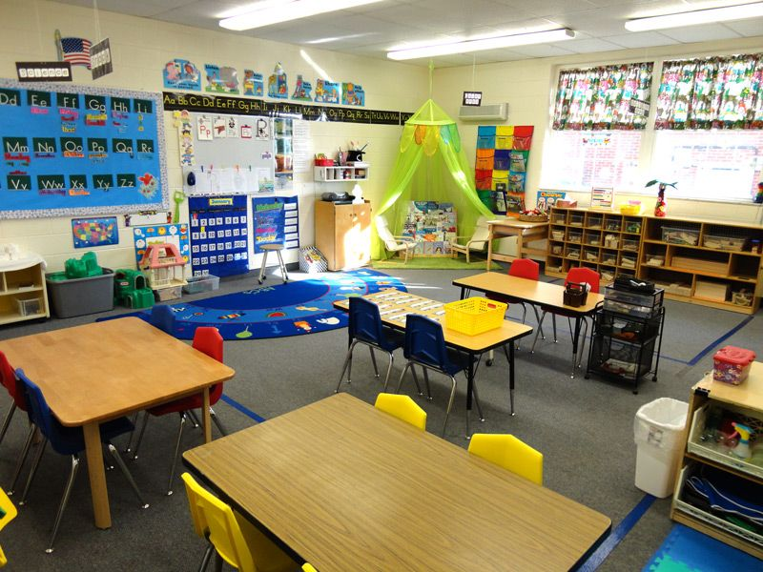
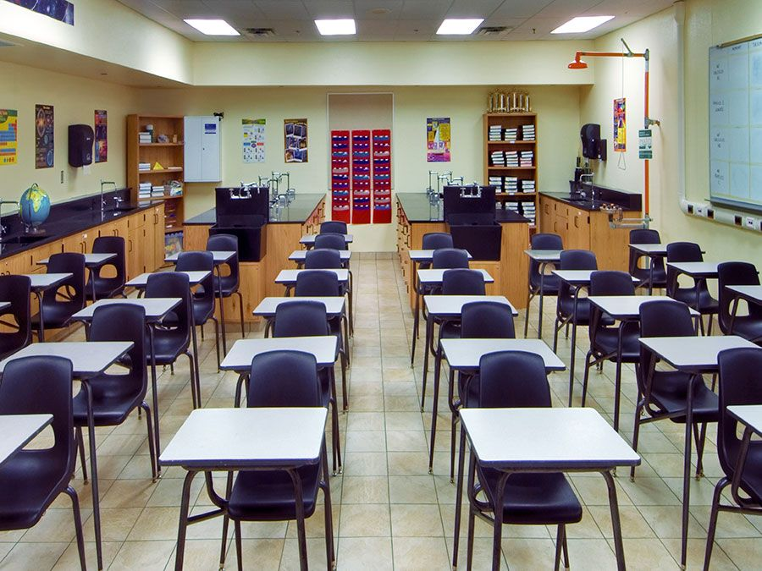
Constraints Arise from Experience & Expertise
10,000 HOURS

Slide 13
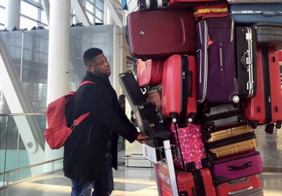

Slide 14
Student Expectations
What do you think your students have learned to expect from teachers before they set foot in your classroom?
Expect you to tell them:
What to work on
How to do the work
What outputs from work need to be submitted for evaluation
How the work outputs will be evaluated
What the consequences of the evaluation will be
Notes:
Then, over years and years of being assigned work and graded by teachers, students learn that teacher knows best.
They also learn – either directly or indirectly – that it’s up to the teacher to tell you…what to work on, how to do your work and how your work will be evaluated.

Slide 15
Expressing Expectations
“Will this be on the test?”
“How many pages should we write?”
“How long do you expect our presentations to be?”
“How do YOU want us to …?”
“What are YOU looking for on this assignment?”
“What will YOU be grading us on (what’s the rubric)?”
“Can you show us examples of good projects?”
Notes:
Just in case these outcomes are not readily apparent to you, let me share a few of the specific ways that they tend to manifest.
First, there is discomfort with even the slightest ambiguity about assignment requirements – how many pages, etc.
Second, there is an implication that the highest purpose of the student’s work is please YOU and meet YOUR idiosyncratic guidelines – what do YOU want us to do?
And finally, there is a desire to avoid having to think about what would make sense or exercise the student’s creativity muscles by having a template or sample projects to emulate.

Slide 16
Learned Keys to “Success”
Follow the formula you’re given
Do the work you’re told to do
Do it the way you’re told to do it
Notes:
The resulting expectations define the antithesis of an entrepreneurial mindset.
Rather than asking “why am I doing it this way?” students are conditioned to do what they’re told in the way they are told.
And rather than asking “how could I make it better?” students are conditioned to believe that the best way to do it is the way that they’ve been told to do it.

Slide 17
Adverse Outcomes of Learned Expectations
Limited understanding of the purpose/goal of the work
Discomfort with uncertainty and ambiguity
Fear of failure
Lack of creative confidence
Inability to adapt to changing task requirements
Fixed mindset
Rejection/disagreement with constructive feedback
Key point: These outcomes highlight the need to eliminate
the excess baggage of learned expectations
that students bring with them.
Notes:
There are a lot of negative outcomes that can be expected to result from year after year of conditioning in traditional school settings. This is a partial list of those that we have seen repeated manifest in University classrooms.

Slide 18
Key Question
What tactics can you use to overcome students’ invisible constraints and show them that their entrepreneurship class(es) will be different?
Notes:
This raises a key question: What classroom tactics can we use to recalibrate student expectations and let them know that their entrepreneurship class(es) will be different?
The next slide provides a list with a few ideas. However, before considering the list, I’d encourage you to take a few minutes to reflect on your own classroom management, assignment specifications, etc. and think about whether you are conditioning students to do what they are told or constantly ask “why am I doing it this way and how can I make it better?”
Specifically, think about your assignment specifications, grading rubrics and provision of sample projects/templates – do they provide well-defined problems to solve in a manner that you have pre-specified or do they provide unstructured problems that students have to figure out how to solve?
Maybe do small groups and then share out

Slide 19
Possibilities
Assign topics where the students will be the classroom experts
Bring in speakers to describe the open-ended, unstructured nature of their work (having to figure it out)
Give low stakes open-ended assignments where students have to figure out how best to respond (medium, length, etc.)
Provide examples of unstructured real world problems and ask students how they would solve them (and communicate their solutions to stakeholders)
Recalibrate your grading scale and utilize general criteria (like “overall persuasiveness”)
Introduce unpredictable, changing task requirements
Solicit third party constructive feedback for students (from a credible source)
Provide a direct statement of recalibrated expectations for students
Notes:
Here are a few possibilities for moving more toward giving students the kinds of complex, unstructured problems that they will need to be prepared to handle to adapt and thrive amidst change:
Have the students be experts and figure out on their own how to share their expertise with their peers.
Expose students to unstructured problems using a variety of means – speakers who are constantly doing new things and having to figure out how to do it along the way, low-stakes open-ended assignments, and projects where making an impact or developing a compelling, novel solution is more important than satisfying formulaic criteria for determining a student’s grade
You can also be direct in sharing a statement of expectations for students so that they know your class will be different.

Slide 21
The Payoff
Overcoming learned, invisible constraints will enable students to derive the full benefit of entrepreneurship education:
Creative confidence
Growth mindset
Resilience
Adaptability and resourcefulness
Problem solving
Self-efficacy & self-determination
Notes:
Specifically, we need to figure out how to reshape students expectations and socialize them to manifest creative confidence, a growth mindset, resilience, adaptability and creative problem solving
Paper airplane and ‘ideal first day’ activities suggest early early in curriculum – help students themselves to understand as they look at ideas how hidden assumptions become constraints

Slide 22
Break
Return at 10:18am

Slide 23
Unlocking the Creative Potential of Your Students

Slide 24
Reflection: Self Creative Best
Reflect on a time that you felt most creative.
  What were the conditions/context/environment?
  How did you feel? Throughout the process? At the end?
  Take 90 secs to share with your partner.
  Partner summarize what you heard.
  Switch. Repeat. Return.

Slide 25
Creative potential within all students
Creativity is a skill, not a talent, that can be developed.
In order to develop it, students need:
  Confidence
  Practice
  Semi-structured
  Safe environment

Slide 26
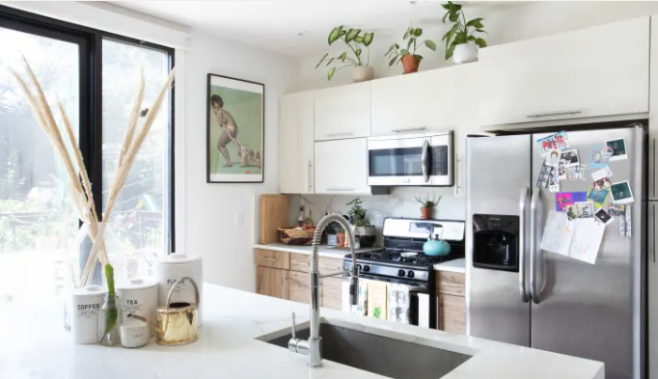
The Kitchn Product Review
This Compact Microwave Does the Job of an Air Fryer
and Convection Oven and Saves Me So Much Counter Space
https://www.thekitchn.com/ge-microwave-oven-air-fryer-review-23624107

Slide 27
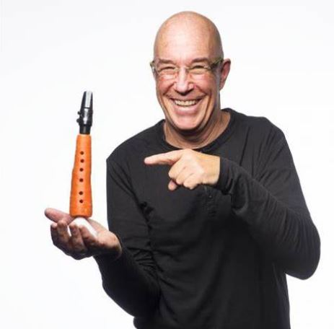
Delicious Musical Magic
Linsey Pollak and the Carrot Clarinet
Watch his TedTalk
https://bravowaukegan.org/linsey-pollak-and-the-carrot-clarinet/

Slide 28
Creative Combinations
In partners/small groups, take 5 minutes to combine two objects (choose just two if needed).
  1 min – Silent idea generation individually
  4 min – Share out all ideas and decide
Consider:
  What can I combine so as to maximize the number of uses?
  What can I combine in order to lower the costs of production?
  Which materials could I combine?
  Which are the best elements I can bring together so as to achieve a particular result?

Slide 29
Facilitation Notes
CREATIVE muscles get stronger through EXERCISE
Create SPACE for vulnerability
  Low stakes
  All voices
  Best idea wins
STRUCTURE without prescription
What will you need to do to create a context for your students to build their creative confidence?

Slide 30
Creativity with a purpose
Value matters but…
All in the eye of the beholder
Take 3 minutes to prepare a persuasive 30 sec pitch of your product considering your stakeholder group
  Group 1: coffee shop owners
  Group 2: first year teachers
  Group 3: grandparents
  Be prepared to share when we return!

Slide 31
Returning Educator Panel

Slide 32
Contact Info
Bob Seefeldt, Bishop Shanahan
  rseefeldt@shanahan.org
  semester, companion
Sandra Starkey, Penncrest
  sstarkey@rtmsd.org
  full year, companion
Bethann Higley, Padua
  bhigley@paduaacademy.org
  full year, dual
Jennifer Vail, MOT
  jennifer.vail@mot.k12.de.us
  full year, dual

Slide 33
Wrap Up
Reflecting on the year ahead in two sticky notes:
  What do you believe will be most difficult about the program for you/your students/your school this year?
  What are you wondering about that you hope will be answered this afternoon?

Slide 34
Lunch
Enjoy - Engage with others – Get some fresh air!
Return at 12:50pm

Slide 35
Afternoon Session

Slide 36
Detailed Agenda for Today
9:30am Overcoming Your Students’ Invisible Barriers
10:20am BREAK
10:30am Unlocking the Creative Potential of Your Students
11:00am Returning Educator Panel Discussion
12:00pm LUNCH
12:50pm Love it!
1:05pm Design Sprint
2:10 pm Design Sprint Facilitation
2:30pm BREAK
2:40pm Resources and Canvas
2:55pm What is it?
3:05pm Consider the Calendar
3:25pm Questions/AMA
3:50pm Reflection and Wrap Up

Slide 37
Morning Takeaways
What’s one takeaway from this morning?
  Could be an insight, an activity, something about your students, etc.
  Even if it seems small, capture it now—it might be the thing that sticks with you all year.
Write it down somewhere!

Slide 38
Love It!

Slide 39
Love It!
Kitchen object needed!
60 seconds to present/sell/pitch/describe the GREATNESS of your object
2 minutes to prep

Slide 40
Love It! Facilitation Notes
Any object works – the more common the better! Pencils/pens are a great option, paperclips, stapler, etc
Purpose: practice pitching, specifically thinking about:
  How to connect with an audience/adjust their message accordingly
  Fake excitement/passion
  Building confidence ‘on stage’
Consider having students start in small groups and in time building their confidence to pitch in front of the whole class.

Slide 41
Design Sprint
External Engagement

Slide 42
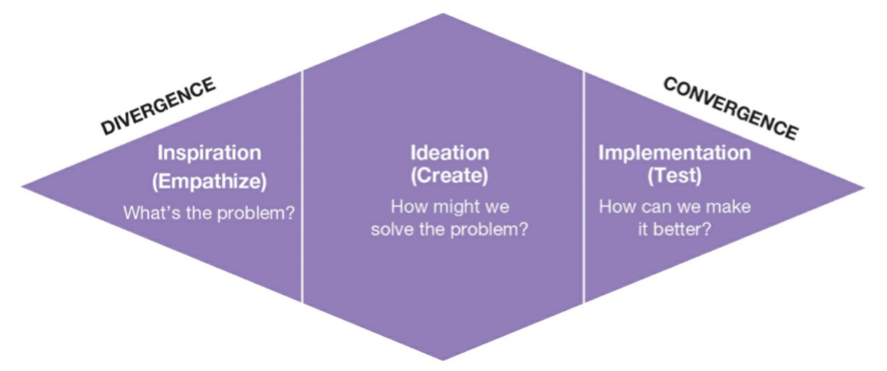
Design Sprint

Slide 43
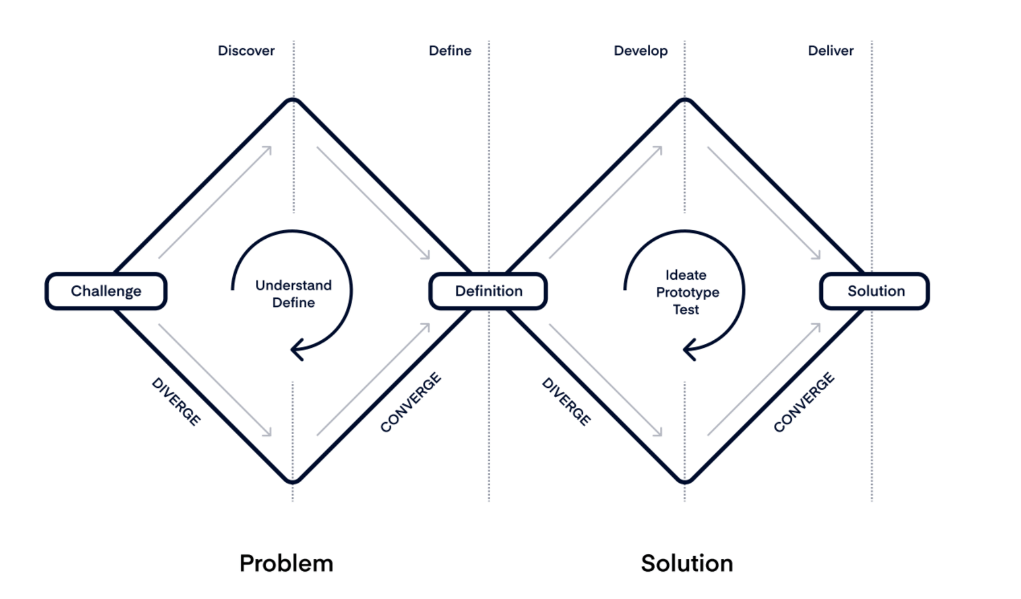
Design Sprint

Slide 44
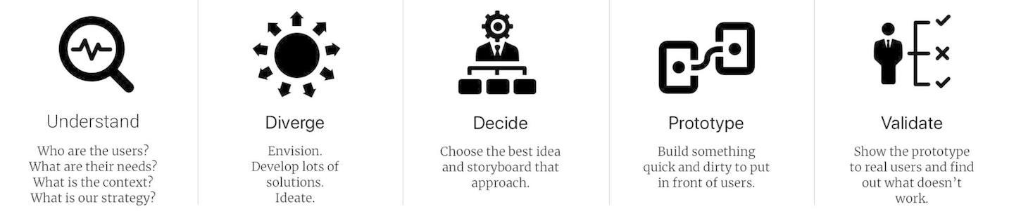
Process
Notes:
Insert the problem in need of creative problem solving here. Don’t ask a ‘how might we’ question yet.

Slide 45
Today’s Topic
Educators often plan and teach within the boundaries of their own classrooms or schools. But when we engage people and organizations beyond the traditional classroom boundaries, we unlock powerful opportunities for authentic learning, real-world relevance, and student impact.
Notes:
Insert the problem in need of creative problem solving here. Don’t ask a ‘how might we’ question yet.

Slide 46
Step 1: Understand the Problem
Explore various facets of the problem: Who are the users? What are their needs? What’s the context? What are the goals? What’s the strategy? Why does it matter?
Collaborate in groups, take notes on Zoom Whiteboard.
In the final minute, write a “How might we…” question that will be used for divergent thinking
Notes:
Best to give a set amount of time for digging into the problem and then a few minutes toward the end to encourage groups to ensure they write a problem statement.
Note: (Ideally) Include primary research – discuss with target group to gain full understanding – and secondary research
Share link in groups:
group 1 - https://jamboard.google.com/d/1lvjCzzHcic6gNqUb_wYLt2qwMmVc4xPSWspWbkOTMeg/edit?usp=sharing
Group 2 - https://jamboard.google.com/d/1JupuibdnsAik_IeBwHukI6N2hhwRn9WmiPQX_v2zkcE/edit?usp=sharing
Group 3 - https://jamboard.google.com/d/1qO5p_Uuciy_uvf1HMKi11AnkOOB7DhsY-XJ_xnP0guQ/edit?usp=sharing

Slide 47
How might we…
collaborate with others outside of our individual classroom?

Slide 48
Step 2: Diverge
Generate a list of as many possible solutions as possible
4 Rules for Brainstorming
  Go for quantity, not quality
  Defer judgment
  Build off the ideas of others
  Go for crazy ideas
Start silent (individual) before whole group
Notes:
Remind participants that judgement can be verbal or expressed through body language and facial reactions. Judgement also happens in our own heads and we need to be mindful to letting idea flow good, bad, or anything in between.

Slide 49
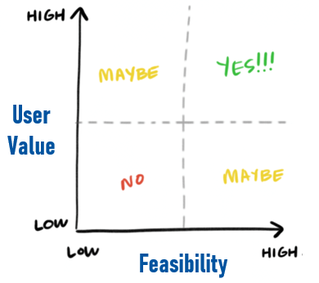
Step 3: Converge & Decide
Narrowing down the possibilities using established criteria to identify the most promising options worth of pursuing.
Today’s Criteria:
  Feasibility – How ‘easy’ will it be to achieve success? How much time, effort, money and other resources will be required?
  Impact – If the action is successful, how much value will be created? What consequential benefits/improvements will be realized?
Be prepared to share your best idea
Impact
Feasibility
Notes:
You may choose other criteria – there may be a budget or timing constraint that will need to be considered. If there are multiple criteria, it may be helpful to put it into a chart and include a weight relative to the importance of the criteria.

Slide 50
Sharing Ideas

Slide 51
Step 4: Prototype
Create a quick tangible deliverable (mockup, physical product, etc)
Share with experts/users to gather feedback
Iterate and refine based on feedback
Repeat as necessary

Slide 52
Step 5: Validate
Real world implementation and testing
Continue to seeking user feedback and iterate

Slide 53
Design Sprint Reflection
How do you feel after that experience? What helped you? What inhibited you?
What implications do you have for your own classroom?

Slide 54
Design Sprint Facilitation

Slide 55
In-School Applicability
Deciding when/where to stop
  Don’t skip the ‘understand phase’.
  We often stop after the converge phase for presentations/sharing.
Broad applicability and use
Design sprints work well with topics/challenges that are:
  Real, urgent, meaningful
  Have no clear/right answer
  In need of creative problem solving
  Open ended but not too open
Recommended in 1.6 as well as a few other spots in the curriculum

Slide 56
Facilitation Notes
Timing
  60 min minimum for work time will be needed; could do 3 day, one phase per day approach
  Keep a timer running and visible at least for yourself, it can be helpful to add time above what was stated if the conversation and creativity are flowing
  Convergent thinking is often the most variable for groups. Typically give more time for this than divergent thinking or understanding the problem. For groups who arrive at one solution quickly, have them begin developing how they will present the solution or building a prototype.

Slide 57
Facilitation Notes
Participants
  Recommend groups of 3-5 people
  It’s challenging to both lead and participate in a sprint. If you want to be an active voice in the problem solving, consider a third-party facilitator.
  Be mindful of group dynamics. Having diverse perspectives in a group is important, but you will need to create a space that all voices and ideas will be heard and valued.

Slide 58
Facilitation Notes
Exercise Tools
  Solo flight
    Specific time for silence and individual thought before group share outs.
  Take 2
    Each group member shares their ideas or thoughts for ‘2’ minutes. You can choose any number here. This ensures all group members have equal voice time which helps to limit the loud and encourage the quiet.
  Dot voting
    With many ideas on the table or potential solutions, each person is given three dot stickers and an opportunity to vote for the best idea from their perspective. This might be followed by a ‘take 2’ for people to explain their votes. This can help with consensus building but generally consensus doesn’t always equal the best idea. Ensure there is discussion before selecting a move forward solution.

Slide 59
Facilitation Notes
Tangible Tools
  Sticky notes are highly encouraged. Having the tangible representation of individual ideas helps.
  Impact vs Feasibility matrix – if using these criteria, have participants draw a matrix or have one preprinted.
  Camera – take a photo of final matrix or be sure ideas not chosen are captured as these often become helpful to look back on in the future.

Slide 60
Break
Return at 2:45pm

Slide 61
Resources & Canvas

Slide 62
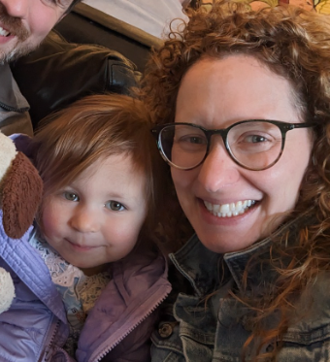
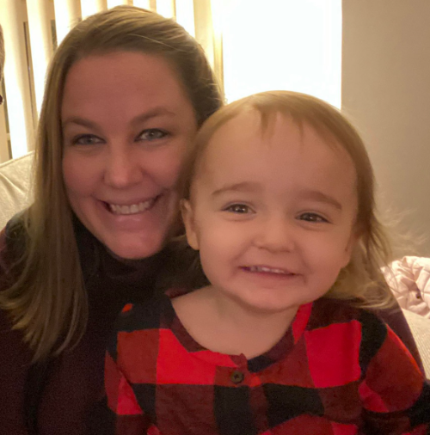
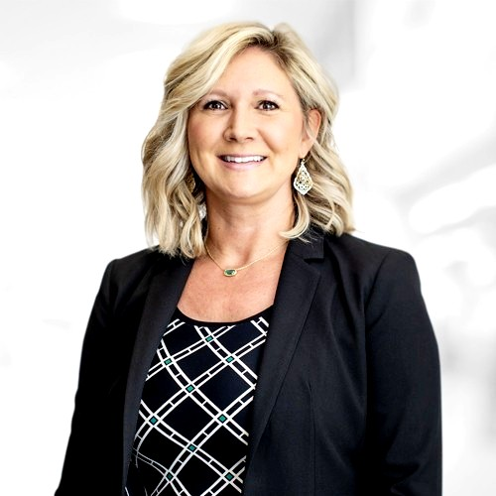
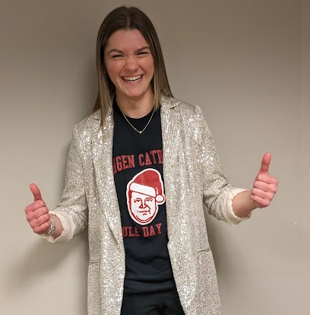
Felicia
Harrington
feliciah@udel.edu
Melanie
Schleiniger
mschlein@udel.edu
Rebecca
Wasniewski
rwas@udel.edu
Maggie
Nelson
magsnels@udel.edu

Slide 63

New Arrival: Jan 2026

Slide 64
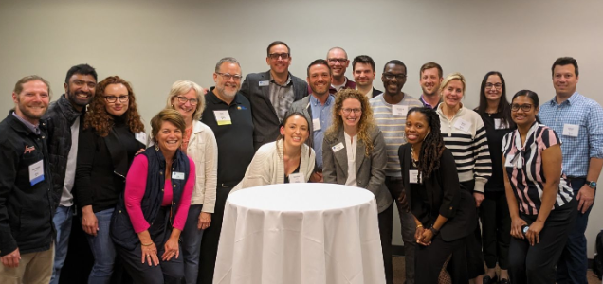

Slide 65
Educator Toolkit
https://horn.udel.edu/entrextoolkit
PW: “udelteach”
Please do not share outside of the network or with students.
Go-to source for all EntreX resources and information

Slide 66
Canvas Tips
Self-enroll vs. invitations
  Ask IT to whitelist “notifications@instructure.com”
Collect and keep student passwords
Unpublish modules until you get there
Collect and keep student passwords
Canvas vs. School LMS
  Do what’s necessary/required and no more
Collect and keep student passwords
Check the toolkit guides; Ask for help

Slide 67
What is It?

Slide 68
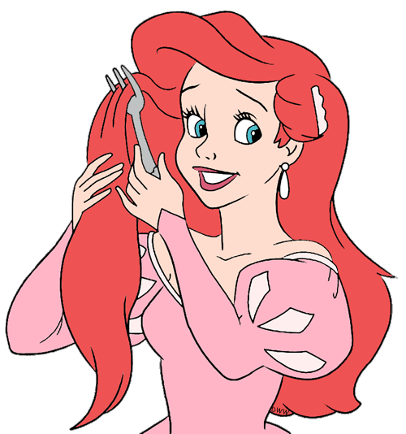

What is it? / Alternative Uses
Notes:
Common household object – fork
Ariel’s perspective – a dinglehoper

Slide 69
What is it? / Alternative Uses
Evaluate your list
  Fluency – how many items you named
  Originality – how common was your answer
  Flexibility – how many unique subject areas
  Elaboration – detailed level of response
Notes:
Evaluate your own list on these four areas. Not always about quantity.
Great exercise to try out inside of the classroom several times. See how students grow in the four areas. Might consider having a round focus on a specific area.

Slide 70
What is it? / Alternative Uses Facilitation Notes
Present your students an object (hairbrush, kitchen spatula, plastic cup, anything!) Consider using something very common and then later something they won’t know what it’s “actual” use is!
Provide 60 seconds or 2 minutes for students to write a list of what the object “could be” or “alternative uses”
Encourage students to ‘evaluate’ their list in different ways.
Quick activity to help stretch the divergent thinking muscle for students. Using this a few times can help expand mindsets and show students how their skills are increasing.
Notes:
Common household object – fork
Ariel’s perspective – a dinglehoper

Slide 71
Consider the Calendar

Slide 72

Pacing
Module 0
4 sessions
Module 2
21 sessions
Module 4
9 sessions
Module 1
11 sessions
Module 3
11 sessions
Module 5
8 sessions
Companion
3 sessions

Slide 73
Pacing Guide

Slide 74
EntreX Important Dates
Course Launch – this week*
Grades
  Dual enrollment – gradebooks complete by May 20
  Companion – deliverables submitted by May 15
Competition Events
  Expect registration to be 1-2 months prior
  Expect final confirmation to be 1-2 weeks prior

Slide 75
EntreX Event Calendar
Delaware Connect
  In-person October 9 (9am-1pm) – limited capacity
  Virtual October 16
Venture Showcase
  Regional – February 25 @ Rutgers New Brunswick
  Delaware – March 5 @ UD
Limitless World Summit
  April 23-24 @ Chase Center in Wilmington, Delaware
Diamond Challenge Submission deadline: Jan 15
(separate discussion coming)

Slide 76
Competition Series
School based pitches first
Venture Showcase: One team each track to compete; whole class may attend
Regional @ Rutgers Feb 25; Delaware March 5
School considerations
  When? Note: Teams submitted one week prior to venture showcase
  Who do you want to see it? (other students, admin, community, parents)
  How much time can you commit to organizing an event? Who could help?

Slide 77
10 min Planning time
Rough sketch your first day/week
5 min sharing time with a partner for feedback or to talk through anything

Slide 78
Questions/AMA Session

Slide 79
Presubmitted questions
Lesson planning and Competition details
Group chat/network wide competition
1 semester duration / pacing
How do you break parents’ perspectives of a how a class should go?
When should things be completed by
Dual vs companion

Slide 80
What happens next?
Complete the survey!
  You’ll gain access to your course early next week as long as you’ve completed the survey
  An email will be sent once you’ve been given access
Follow the Launch Guide
Schedule an Implementation Call
  Recommended for within your first quarter of class

Slide 81
Launch Guide
One page guide of things to do in the next month
Highlights:
  Add us to your email contact list
  Updating your canvas course (with your info, course deadlines, etc)
  Attend webinar/watch summary video on course credit process
  Create your LinkedIn profile
  Submit your course roster

Slide 82
Reflect and Wrap Up

Slide 83
Reflect
At the end of the year, how do you want your students to describe the course?
What will it take for you to make this come true?

Slide 84
The end… but only the beginning!

Slide 85
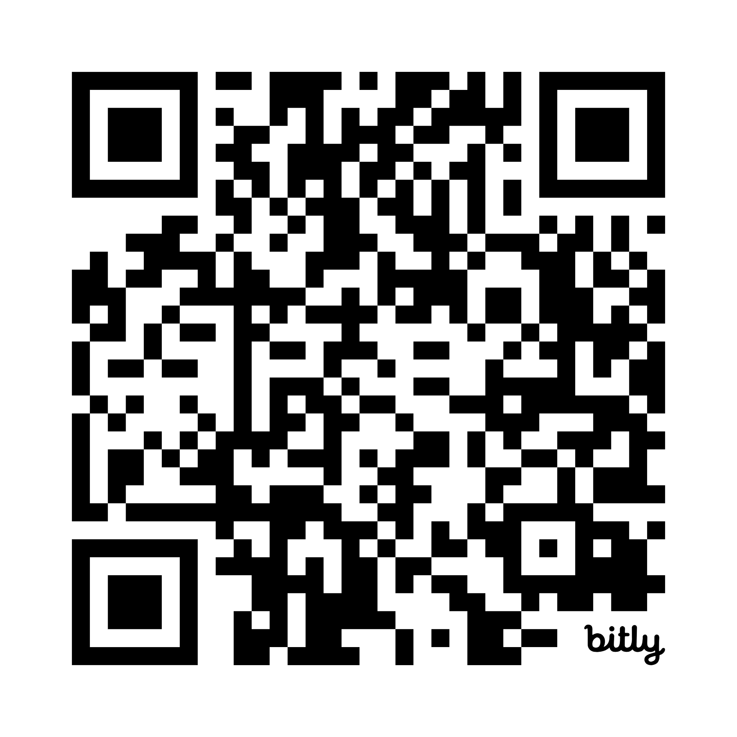
Survey
Please complete the survey - Your honesty helps us learn, iterate, and improve!
  Specifics on course – provide as much info as you know
  Delaware Connect Event
  Educator Meetup Timing
Bit.ly/PostPD25

