Slide 1
Market Sizing & Go To Market Strategy

Slide 2
Why Market Size Matters
Launching a startup requires significant investments of time, money and other resources
Even if the total investment represents an “acceptable risk” it still comes with opportunity costs (the potential value of foregone alternatives that were not pursued while this one was)
Before launching you should ask yourself: “Will it be worth it?”
In other words, even after you validate that you’re solving a real problem with a solution that offers unique value, you still need to determine whether it is worthwhile to pursue
Estimating market size helps to provide an answer to this question
Market size: number of customers who are willing and able to buy a product times the amount spent per customer (can also be thought of as market value)
Market size estimates are usually framed by geographic and time boundaries (for example, revenues for U.S. sales in a given year)
Notes:
The entrepreneurship process involves two distinct components – search and execution.
Many entrepreneurs confuse the two and do so at their own peril. Specifically, many entrepreneurs try to skip searching and go directly from idea to execution. This works only in the rare circumstance where their business model vision, and all of the untested assumptions it incorporates about how the venture will create, deliver and capture value, turns out to be 100% valid.
Engaging in search is critical for managing the high levels of risk associated with attempting to bring new ideas into the marketplace and avoiding the #1 startup mistake: building something that no one wants.
As a general rule, entrepreneurs should seek to gather evidence and use it to guide their decisions. During search, such evidence will help to guide iterations and pivots in the business model vision. During execution, evidence can be used to optimize and continuously refine the model to improve performance.

Slide 3
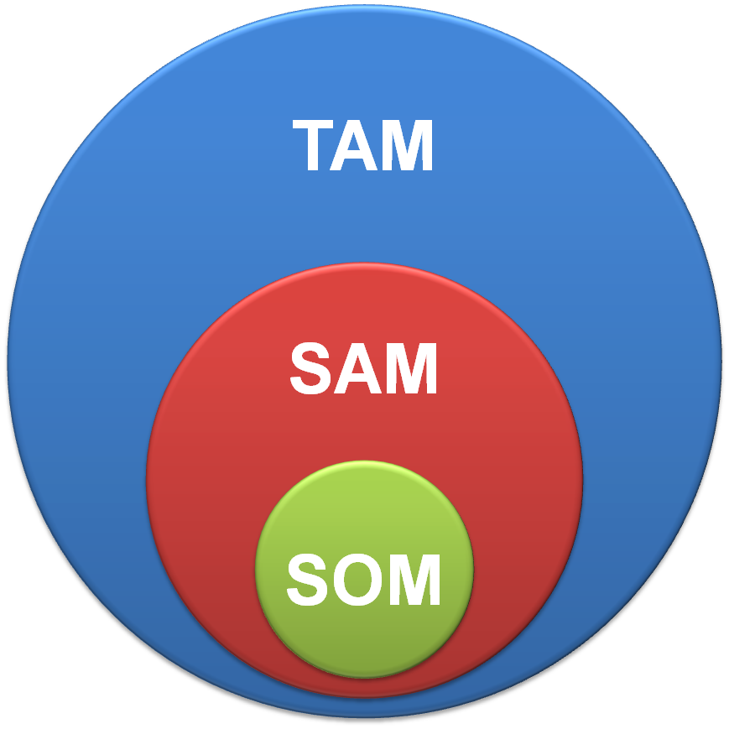
TAM, SAM, SOM
Answering the question of whether it will be worth it depends on your personal goals and TAM, SAM, SOM
Personal goals might include running a startup as a side hustle, lifestyle business or wealth generator.
TAM refers to total available market.
SAM refers to served available market.
SOM refers to served obtainable market.
They are ordered as TAM > SAM > SOM
Notes:
During the search process it is best to think of your venture as a temporary organization. In other words, it is something that can be disassembled quickly if your ideas are invalidated by evidence.

Slide 4
Estimating Market Size
Think of it as “guess-timating”, as there can be a lot of uncertainty, especially for new products with a high degree of unique value
Best to use multiple methods to triangulate – top down, bottoms up, third party research, value approach
There are no right answers; pressure test using data, logic and expert opinion to ensure estimates are credible
Hard to do well
Consulting firms frequently use market sizing problems during interviews to test candidates’ abilities to use data and logic to estimate the unknown

Slide 5
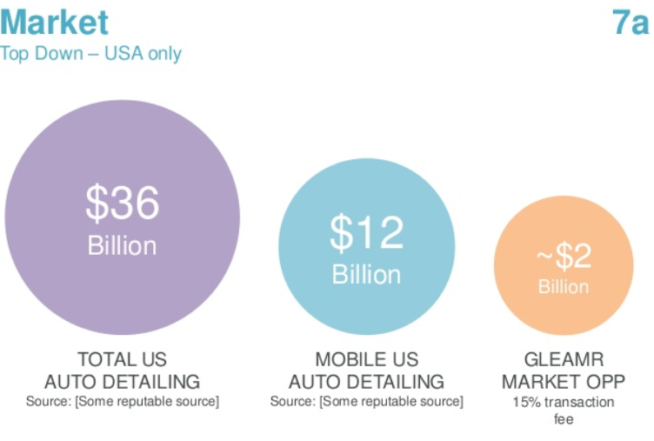
Market Size: Top Down Example
TAM
SAM
SOM

Slide 6
Market Size: Example (Continued)
Credible sources and/or #’s supported by evidence from your own experiments will make a bottom up estimate compelling
TAM -
SAM -
SOM -

Slide 7
Go To Market (GTM) Strategy
Developing a go to market strategy is critical to success.
GTM strategy needs to address:
Who, specifically, will you be targeting when you go to market?
How will you position your product vis-à-vis competitors’ offerings?
What value proposition & messaging will customers find most compelling?
What specifically will you offer (brand, product, price)?
How will you reach customers with your offer?
What adoption/sales rate can be expected?
Where will your product be sold? How will it be delivered? Serviced?
Notes:
Understanding the problem is critical to developing a solution that will offer unique value to customers.

Slide 8
Connecting GTM and SOM
Your estimated SOM is connected to your GTM strategy
Many founders forget that any prospective customers who cannot be reached by your planned GTM efforts cannot be obtained.
Only the segment(s) of target customers within the served available market who are both reachable via your planned marketing efforts and likely to be interested in your offer(s) should be included in estimating SOM
For example, the developers of one new indoor sports facility for youths should only consider local leagues and perhaps regional tournaments in their estimate of SOM; however, developers of a chain of such facilities could include all of the markets they plan to enter in their SOM

