Slide 1
Founder’s Curse and Other Special Challenges

Slide 2
Special Challenges for Technology-Based Innovation & Entrepreneurship
Founder’s curse
Protecting intellectual property
Choosing a beachhead for your landing platform
Capital intensity & regulatory hurdles
Lengthy technology development cycles
Complex value chains
Notes:
Successfully translating a new invention or scientific discovery into a value creating innovation presents all of the standard challenges associated with entrepreneurship – for example, developing a unique value proposition, establishing a repeatable sales process, and ultimately iterating your way to a viable model for creating, delivering and capturing value from your new idea.
It also presents several special and often-times inter-related challenges, including:
1. Avoiding the founder’s curse
2. Protecting your intellectual property
3. Choosing a specific market to focus on to establish a beachhead
4. Raising a lot of money
5. Persisting through lengthy technology development cycles
6. Figuring out how to fit your new technology into a complex value chain
In this session we are going to drill down briefly on each of these topics so that you can keep them in mind during later sessions of the course when we will be exploring some specific new technologies.

Slide 3
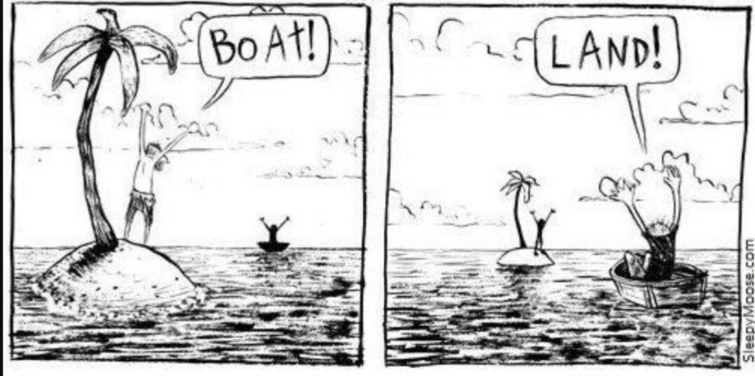
Founder’s Curse
Notes:
Let’s start with the founder’s curse.
In the context of technology innovation, the notion of the founder’s curse is based on two things: (1) the psychology of gains and losses, and (2)
a difference in perspective between the founder and potential customers

Slide 4
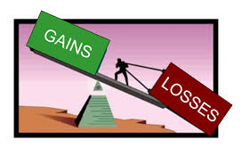
Founder’s Curse: Losses Loom Larger than Gains
Notes:
So, what’s involved in the psychology of gains and losses. Well, according to one powerful, very well researched and Nobel Prize winning observation from behavioral economics – humans demonstrate a consistency in experiencing losses more intensely than comparable gains. Or stated simply, losses loom larger than gains.
To illustrate this phenomenon consider how you would feel if you won $10. Pretty exciting, but not necessarily thrilling right? Now consider how you would feel if you lost $10. If you are like most people, the negative feelings associated with losing $10 would outweigh the positive feelings from the $10 gain.
This notion – that losses loom larger than gains – provides the psychological basis for the founder’s curse.

Slide 5
Founder’s Curse: A Difference in Perspective
New Product
Existing Product
Potential Customer
Founder/Innovator
Notes:
To understand the psychological basis for the founder’s curse it’s important to understand that gains an losses are evaluated from our current perspective (or reference point).
From the perspective of a potential customer, a new product based on a novel technology will be perceived relative to whatever products are already owned/possessed. In other words, current product(s) serve as a reference point for potential customers when they are evaluating new products. From this reference point, any new product is likely to be perceived as offering uncertain gains and certain losses (in the form of having to pay for them). As a result, the losses associated with buying new products can be expected to loom larger than promised gains, making customers slow to embrace the new technology-based product.
In contrast, the founder or innovator sees the world from a different perspective. In contrast to the potential customer, the founder sees the new product she’s developing as the reference point. As a result, existing products appear to offer certain losses (less valuable features and benefits) and little or no gains. Thus, the founder or innovator is likely to be baffled by potential customers who accept the limitations/losses associated with existing products while generally failing to appreciate the superior features and benefits of her new product. It is this Founder’s Curse, and the associated, diehard conviction that it leads founders/innovators to hold for their new products, that often leads innovators to waste a lot of time and money pursuing the development of products that no one wants.

Slide 6
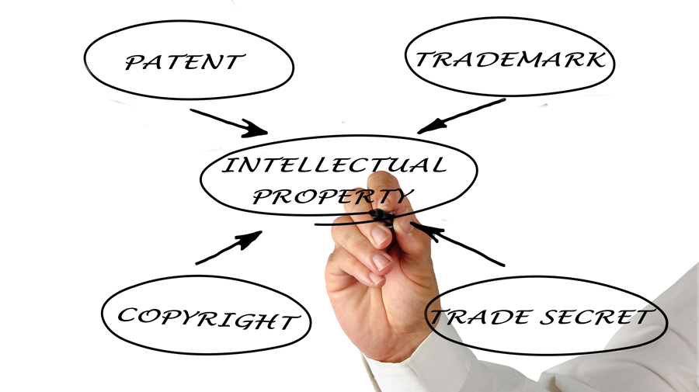
Intellectual Property
Notes:
A second special challenge associated with technology-based innovation and entrepreneurship is intellectual property (or IP).
As this graphic shows, there are a variety of types of IP including patents, trademarks, copyrights and trade secrets.
In the context of technology-based innovation and entrepreneurship, intellectual property is often the primary source of value and differentiation for new company or product. Thus, it’s important for innovators/founders to understand how to secure protection for their IP, thereby mitigating the risk that someone else will simply copy your novel idea or invention. Under U.S. patent law, the first to file for patent protection is generally the only one who might win the right for protection, provided that her invention is non-obvious and has not been publically disclosed prior to filing.
Intellectual property law can be quite complex and may involve filing for both domestic and international rights. Thus, it’s generally best to consult a lawyer if you believe that you’ve invented something that might be valuable. Horn Entrepreneurship invites IP lawyers to host drop in office hours at UD on a regular basis. So, if you have any specific questions about something you’ve invented, please pay us a visit.

Slide 7
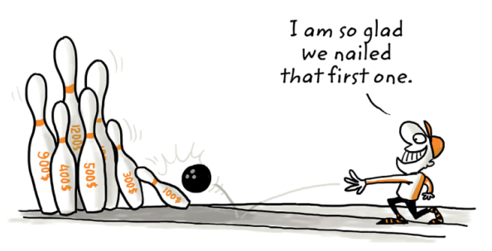
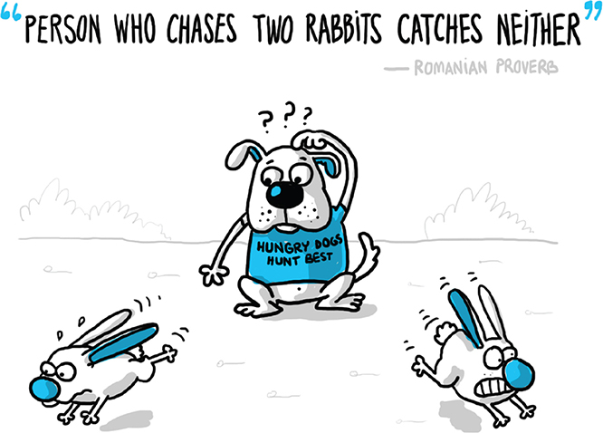
Establishing a Beachhead
Notes:
Many new technologies can be considered platform technologies. What this means is that they have a variety of possible applications or uses. For example, artificial intelligence can be used in many different industries for many different applications, from making automated decisions on loan applications to determining how best to adjust water, nutrient and lighting levels to optimize plant production.
The special challenge that this creates is having to choose a beachhead market for focus on. For those of you who may have watched WWII movies, you probably understand the meaning of a beachhead market. Basically, it refers to a smaller initial market that you can focus on to establish a reliable revenue stream that can then be used to expand to other, larger markets (or applications of the technology later on).
As this second cartoon illustrates, startups typically have limited resources and need to focus on a single use or market because if they spread themselves too thin attempting to pursue two applications or more, then they will fail to establish a beachhead in either.

Slide 8
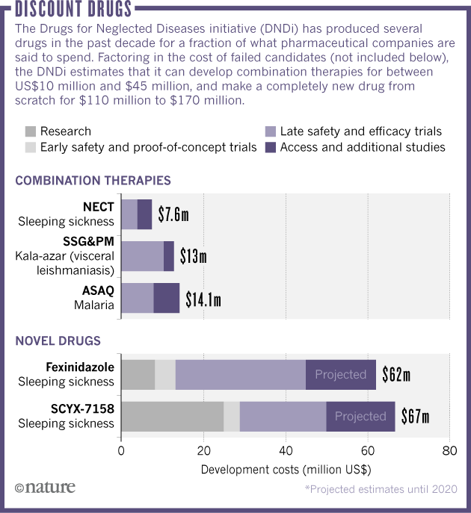
Capital Intensity
Notes:
Technology-based innovation can be very expensive because it typically involves high priced talent and expensive equipment. For example, there are several pieces of laboratory equipment at UD that costs hundreds of thousands and in fact, millions of dollars. According the the pharmaceutical industry, the total cost of bringing a new drug to market typically exceeds $1billion. And as this graphic shows, even the most efficient efforts that focus on simply combining two existing therapies into a novel combination tend to cost more than $10million.
This is A LOT more than it costs to make an web/mobile IT app.

Slide 9
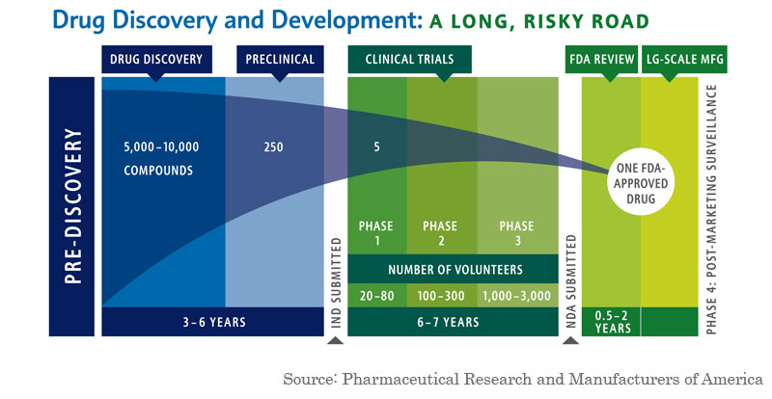
Long Development Cycles & Regulatory Hurdles
Notes:
Part of the reason it can cost a lot to bring new technologies to market is because it simply takes a long time. Again using pharma as an example, it can take more than 10 years from the specification of an initial compound until the receipt of FDA approval to legally market the drug.
Many therapeutics, devices and other technologies that may pose an immediate risk to human health or the environment must also sort through a maze of government regulations and compliance requirements. For example, if you were to invent a wholly new power source, it would likely face considerable regulatory scrutiny to ensure that it did not produce harmful emissions or other unintended consequences.

Slide 10
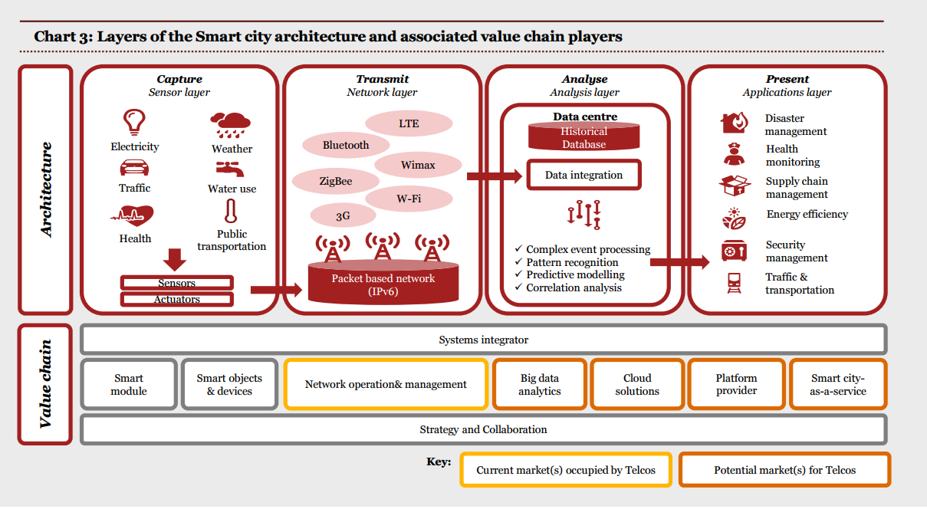
Complex Value Chains
Notes:
The invention of a new power source is also a good example for the final challenge we’ll discuss – complex value chains. Let’s say you came up with a new way of creating electricity at a large scale. To make it work, you would need to figure out how to integrate it into the complex value network for power creation, distribution, storage and use.
Similarly, in this example, you can see all of the components involved in creating, delivering and capture value from smart cities. If you were to invent a new sensor or a new telecommunication protocol that was meant to make smart cities smarter, you would need to figure out and convince others that it could be seamlessly integrated into this complex value network without causing disruption. Otherwise, your invention would never become an innovation.

Slide 11
Takeaways
Creating, delivering and capturing value from new ideas is hard
Translating a novel invention into a technology-based innovation and bringing it to market through entrepreneurship is even harder because of the special challenges faced by technology-base startups.
Notes:
I’d like to close this session with two key takeaways.
First, pursuing the creation, delivery and capture of value from new ideas – aka entrepreneurship – is an extremely challenging endeavor.
Second, technology-based innovation and entrepreneurship are often even more challenging due to the special difficulties associated with translating a novel scientific discovery or invention into something that will deliver unique value to customers.
But don’t lose heart, because now you know what some of these special challenges are, and “knowledge is power”. Moreover, the impact you can make through technology-based entrepreneurship can shape the future and literally save lives, as we will discover in the subsequent sessions on specific categories of new technologies.

