Slide 1
Corporate Innovation & Intrapreneurship

Slide 2
The Accelerating Pace of Tech-Driven Change is Shortening Corporate Lifespans

Slide 3
An Innovation Imperative for Future Success
To be successful in the future, a company’s rate of internal innovation must exceed the rate of external innovation
Otherwise, the company will become less competitive (and therefore less successful) over time

Slide 4
Corporate Innovation
Takes places within the boundaries (and confines) of existing aspects of the company, including:
Geography (places of business)
Markets, products and brands
Customers/consumers
Personnel expertise and capabilities
Infrastructure & resources

Slide 5
What are you going to innovate?
We typically think in terms of product innovation, but the innovation imperative applies to all aspects of a company’s operations including its:
Business model
Production/service delivery processes
Internal procedures & workflows
HR/talent development programs
IT, accounting & other internal systems

Slide 6
The (Product) Innovation Matrix
Breakthrough
Innovation
Sustaining
Innovation
Well Defined
How well is the problem defined?
Basic
Research
Disruptive
Innovation
Not Well Defined
Not Well Defined
Well Defined
How well is the domain defined?

Slide 7
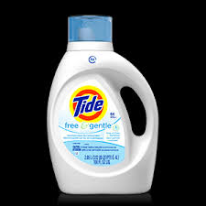
Sustaining Innovation
Innovation that happens on an incremental basis

Slide 8
Transforming Innovation
In between sustaining (incremental) and disruptive – significantly shifts consumption patterns, but does not fundamentally disrupt the market or value chain

Slide 9
Disruptive Innovation
innovation that creates a new market and value network and eventually disrupts an existing market and value network
tooth whitening by dentist
whitening at home

Slide 10
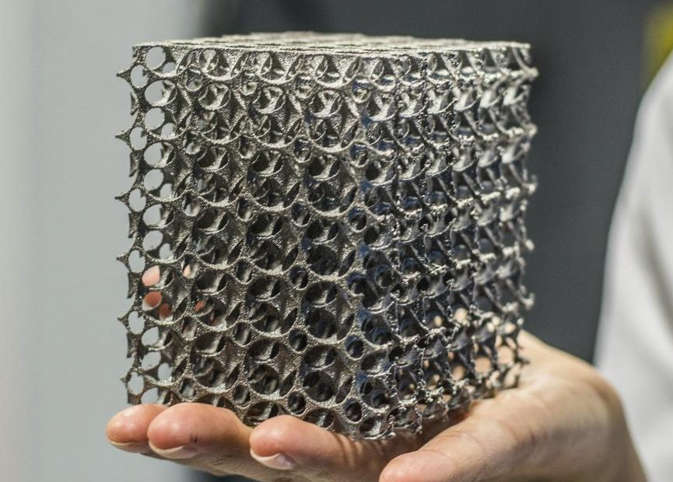
Breakthrough Innovation
innovation that creates new markets and value networks
3D printing of metals
artificial intelligence
biopharmaceuticals & biomedicines

Slide 11
Intrapreneurship
Intrapreneurship: behaving like an entrepreneur while working within an established company (or organization)
Intrapreneur: an employee who is given financial support and autonomy to create new products, services and systems for the benefit of the company
Recruiting, supporting and rewarding intrapreneurs is critical for companies seeking to keep pace with the rate of external innovation
To be successful, intrapreneurs must possess the same general mindset & skillset as entrepreneurs

