Slide 1
Solution Testing

Slide 2
Problem vs. Solution
Phase 1: State hypotheses
Phase 2: Test the problem
Phase 3: Test the solution
Phase 4: Verify or Pivot!
AFTER you validate the problem!

Slide 3
Steps in Solution Testing
First step: Conduct solution interviews
Guides the feature/benefit set for your minimum viable product (MVP)
Second: Test the MVP
Shift to testing the MVP when you have confidence in what your feature set might be
Continue to augment with solution interviews

Slide 4
Solution Interviews
Similar to initial customer discovery interviews, but focused on validating guesses about the solution’s feature set and unique value proposition
A demo (solution test) is the heart of the interview
The demo does NOT need to be high fidelity; rather, it should simply be enough to help the interviewee to visualize how the solution solves their problem(s)
Solution interviews can also be used to provide initial validation of guesses about what customers would pay for the solution (pricing)

Slide 5
Minimum Viable Products
Build the minimum features capable of delivering your value proposition to get feedback
Quickly and iteratively get customer feedback
When you get feedback: add, remove, modify feature set
MVPs provide maximum validated learning with the least effort
Eliminate wasted time, people, material, resources

Slide 6
MVPs: Key Point
You DON’T need to build a physical prototype or fully develop a service offering to test your MVP!!!
There are faster, cheaper and better ways to do it.

Slide 7
Types of MVP Tests
Flyer
Explainer video
Stage a performance
Mock it up with Keynote/Powerpoint
Wizard of Oz / Concierge
Fundraising: Kickstarter, Indiegogo
Physical prototype (of varying fidelity)
Notes:
Wizard of Oz: Zappos
Concierge: Rent the Runway

Slide 8
Resources for MVP Tests
Test Ads: Google AdWords, Facebook
Website Analytics: Google Analytics
Track users visiting website & gives lots of insight
SaaS & PaaS: MailChimp , AWS, Heroku, MongoDB, Google Forms, Chargify
A/B Testing: Optimizely, Unbounce
Landing/Launch Page: LaunchRock, QuickMVP, KickoffLabs [Squarespace, WordPress, Google Sites]
Build a landing page super fast
No coding required & gives analytics & insight

Slide 9
MVP Solution Test: Example
Does the “STEM Diagnostics” value proposition motivate prospective customers to leave their email addresses?

Slide 10
3 Awesome MVPs
Buffer
Dropbox
Zappos
Link to video

Slide 11
Takeaways
Goal of solution testing: continue to de-risk your vision by gathering evidence to ensure that you don’t end up building something that no one wants
Solution interviews help you to determine what features to include in your MVP
MVP experiments help you to determine whether the product your envisioning is perceived as delivering the unique benefits promised by your value proposition (based on the benefits provided by the minimal features)

Slide 12
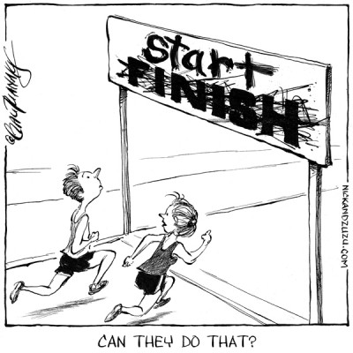
What’s Next?

Slide 13
Building a Company
SEARCH
PROVE
EXECUTE
SCALE
Technology
Flow
Develop
MVP
Build out
POC
Build out
Product
Build
Customer
Support
Team
Yes
Yes
Market
Flow
Identify customer
segment
Hypotheses
Validated?
Validated
Customer
Segment?
Yes
Identify
Pains/ Gains
No
Customer
Creation/
Scale Sales
No
With current team?
Repeatable/scalable sales model?
What?
Early Exit
or Build?
Early
Exit
Acquisition
Team/ Company
Flow
Founding Team – who?
Equity Split – how?
Build
Company
Round out
Team/
Create
Culture
Does team Match Activities?
Raise 2nd Seed Round
Needed?
Round out
Team/
Create
Culture
Financing
Flow
Build Advisory Board
Raise Seed Round
Later
VC
Rounds
No official board of directors
Funded
POCs?
Raise VC “A” Round
Credit: Errol Arkilic

