Slide 1
Entrepreneurial Mindset

Slide 2
Entrepreneurs See the World Differently
When you read these statistics, what do you see?
There are 44 million borrowers who collectively owe more than $1.5 trillion in the U.S. alone
- Friedman, “Student Loan Debt Statistics in 2018, Forbes
14.8% of high school students are obese
2017 YRBSS
1 in 5 college students have anxiety or depression
- The Conversation, February 9, 2018
Notes:
When you look at these statistics, what do you see?
If you have an entrepreneurial mindset, you may see these VERY CONSEQUENTIAL problems as opportunities to make a positive impact.

Slide 3
When You Hear About Worldwide Challenges, What Do You Feel?
Those who possess an entrepreneurial mindset feel compelled to take action.

Slide 4
Entrepreneurial Mindset - Archetype
There is no consensus as to what constitutes an “entrepreneurial mindset,” but we all have pre-conceptions about how they might be different.
What characteristics do you think make up an “entrepreneurial mindset?”
Work with a partner to…
…draw a picture of a person who has an entrepreneurial mindset
…describe their mindset
…provide example(s) of their mindset in action
Notes:
Give students 5-10 minutes to develop profiles of ENTR mindset
Share out and then look for commonalities in their descriptions

Slide 5
Entrepreneurial Mindset: General Characteristics
General characteristics of those who possess an entrepreneurial mindset include:
Questioning of, and chronically dissatisfied by, the status quo
Empathetic, perceptive and reflective
Growth/learning oriented
Perceive the world as full of abundance and opportunity
Predisposed to take action to solve problems (and make a positive impact)
Tolerance for uncertainty, risk
Optimistic and persistent
Believe in self-determination and self-efficacy
Notes:
NOTE: These are all habits of mind and individual characteristics that can be learned/trained. So even if you don’t have much of an entrepreneurial mindset now, you can begin the lifetime process of developing one.

Slide 6
Developing an E-Mindset
Repetition is key to developing habits of mind – ASK YOURSELF:
“why am I doing it this way?” or “why is it being done this way?”
“how can I make it better?”
“what am I assuming and what don’t I know?”
“what is the first/next step?”
Pay attention to the world & your observations & thoughts in opportunity notebook:
Personal reflections – interests, skills, dissatisfactions
Observations – people’s complaints, problems, unmet needs, societal trends, inspirations
Questions – what’s, why’s and how’s
Ideas for improvements and novel inventions
Notes:
Let’s talk about how to begin the process of developing an entrepreneurial mindset.
Like other habits, it takes practice and LOTS and LOTS of repetition.

Slide 7
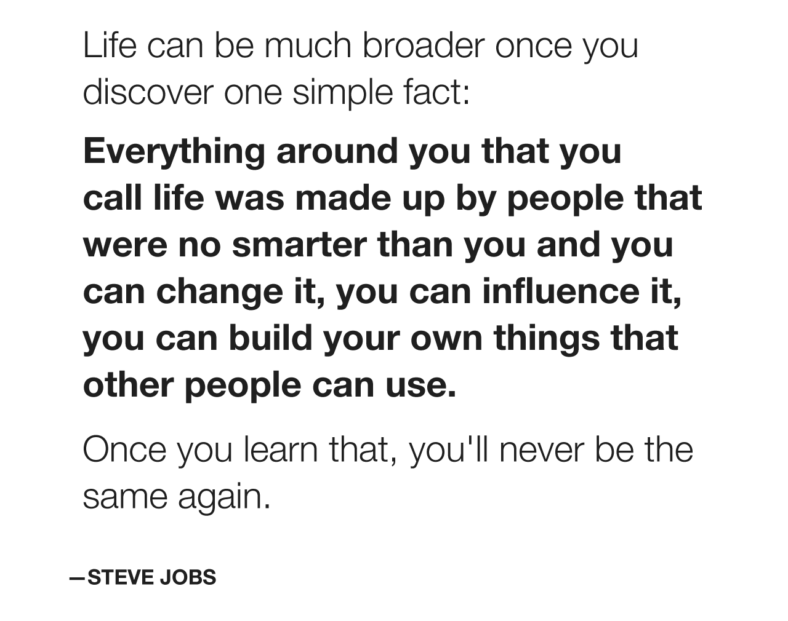
Entrepreneurial Mindset is Transformational
When you develop an entrepreneurial mindset, you will recognize and embody this transformational truth:
Notes:
Embodying this transformational truth is empowering because it means that if you don’t like the way something is…you can work to change it.
This course is all about beginning to develop your means, mindset, skillset and understanding of the entrepreneurship process so that you can put your ideas into action and make a positive impact on the world.

