Slide 1
Effectual Thinking

Slide 2
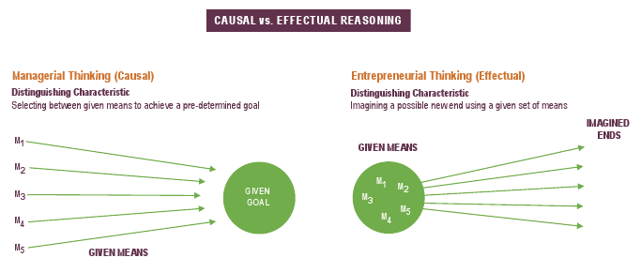
Causal vs. Effectual Reasoning
Source: https://www.effectuation.org/?page_id=207 [October 21, 2018]
Notes:
There is a fundamental difference in the way entrepreneurs think and reason versus the way managers tend to think and reason. Most managers utilize causal reasoning whereby they set the goal they want to accomplish, carefully analyze all of the possible means for accomplishing that goal, and then select the best option.
In contrast, entrepreneurs use effectual reasoning whereby they consider the means they have available and envision the possible ends they can accomplish using those means to determine which ends or goal they want to pursue.
One example that helps to illustrate the distinction between causal and effectual reasoning involves the different ways in which you can cook a meal. If you know what you want ahead of time, then you can cook from a recipe by buying the right ingredients and making the dish (this is causal reasoning); or you can cook by looking at what you have on hand and then determine what you can make (this is effectual reasoning).

Slide 3
Principles of Effectuation
Bird in hand – utilize resources currently controlled or readily attainable
Affordable loss – risk no more than you are willing to lose
Lemonade – invite surprise and make the best of the unexpected
Crazy quilt – build partnerships with a variety of people who can add value to your venture
Pilot in the plane – focus on what you can control and make the future

Slide 4
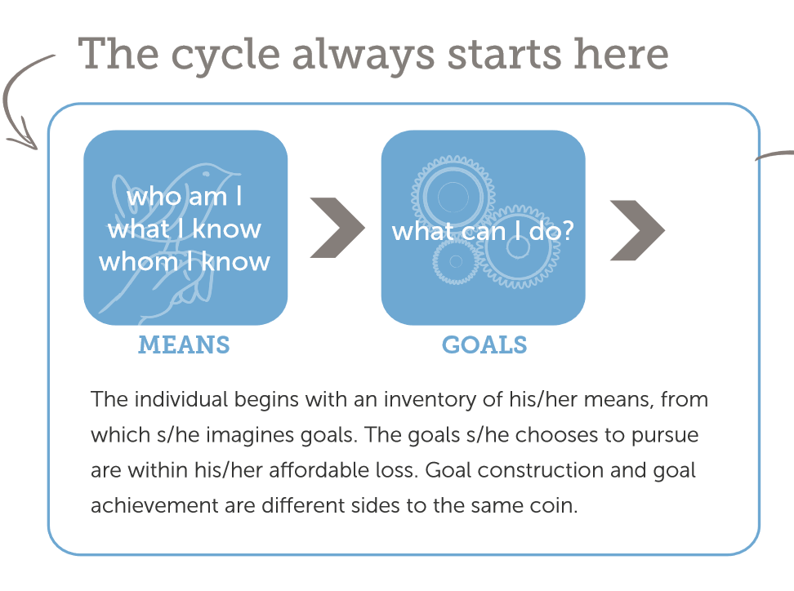
Effectuation Process
Source: “What is Effectuation?” https://www.effectuation.org/sites/default/files/documents/effectuation-3-pager.pdf [October 21, 2018]

Slide 5
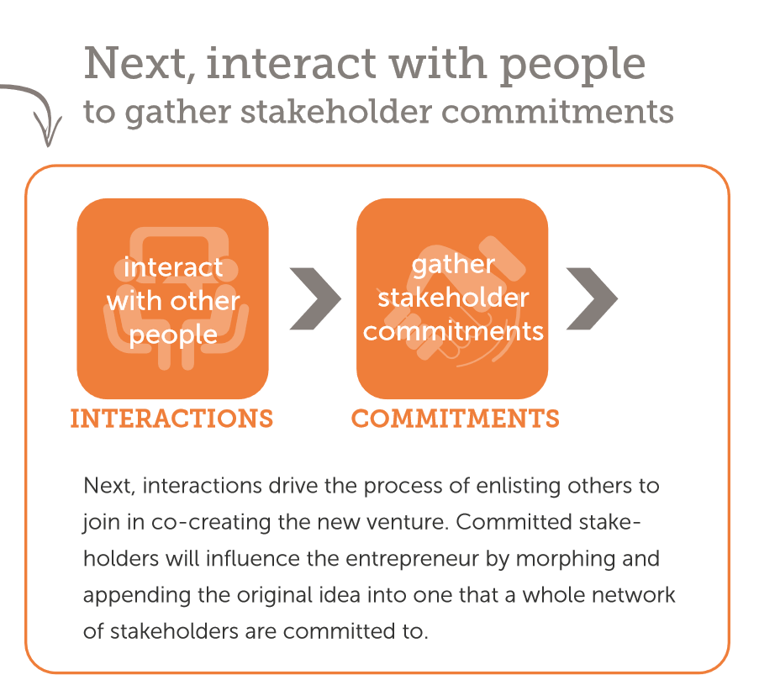
Effectuation Process
Source: “What is Effectuation?” https://www.effectuation.org/sites/default/files/documents/effectuation-3-pager.pdf [October 21, 2018]

Slide 6
Putting it Together
Source: “What is Effectuation?” https://www.effectuation.org/sites/default/files/documents/effectuation-3-pager.pdf [October 21, 2018]

Slide 7
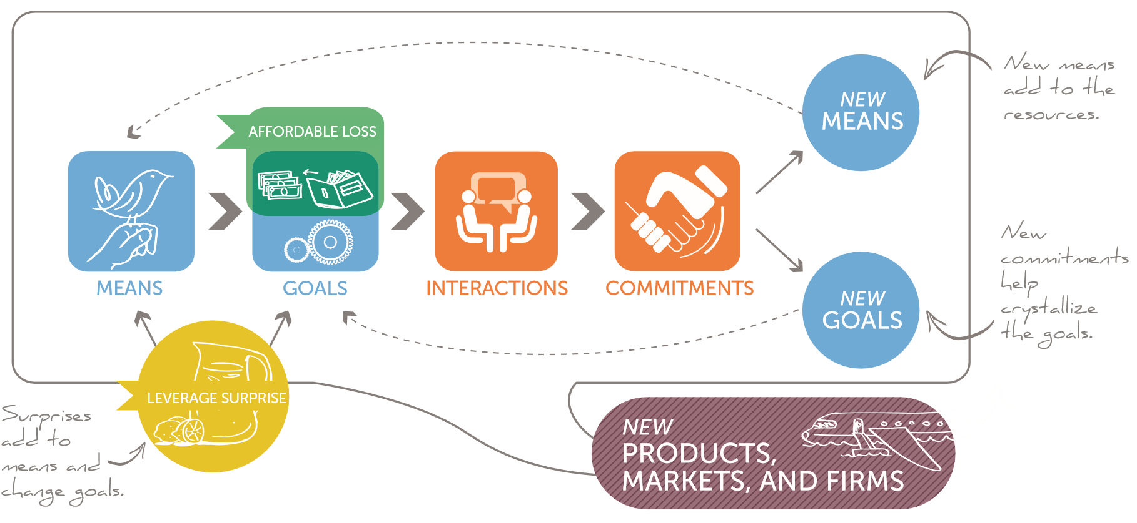
Putting it Together
Source: “What is Effectuation?” https://www.effectuation.org/sites/default/files/documents/effectuation-3-pager.pdf [October 21, 2018]

Slide 8
Context Matters
Causal reasoning works best when making decisions under relatively high levels of certainty
  For example, if I’m marketing an existing product to a well-defined segment that has a history of buying it, then causal reasoning will likely result in better outcomes
Effectual reasoning works best when making decisions under relatively high levels of uncertainty
  For example, if I’m developing a new product and don’t really know whether there might be a market for it, then effectual reasoning will likely result in better outcomes

Slide 9
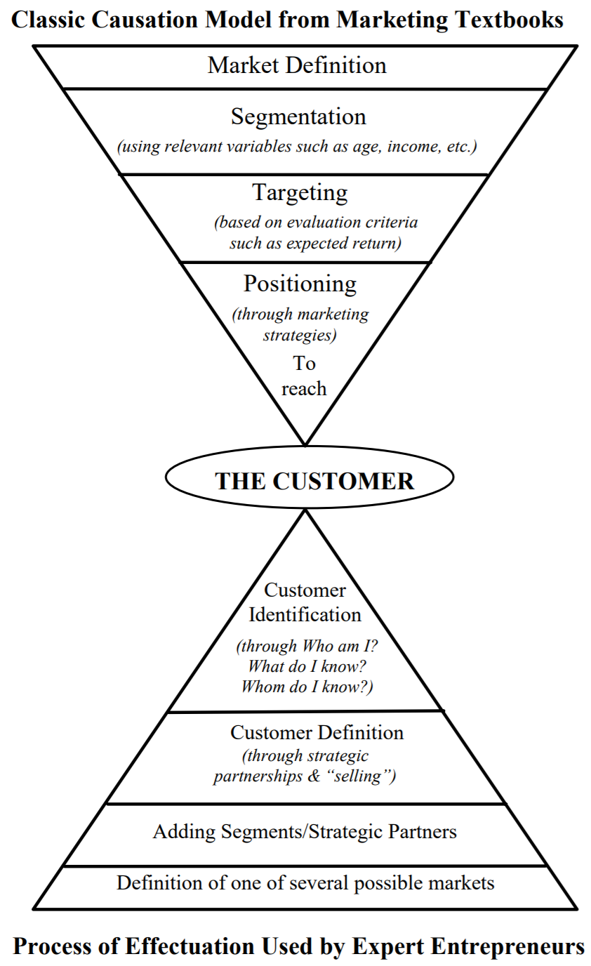
Causation vs. Effectuation
From: Saras D. Sarasvathy, ‘What makes entrepreneurs entrepreneurial?’ downloaded from https://www.effectuation.org/sites/default/files/documents/what-makes-entrepreneurs-entrepreneurial-sarasvathy.pdf [October 21, 2018]
Notes:
Causal reasoning can be conceptualized as a top-down process of making decisions to appeal to a customer.
Effectual reasoning can be conceptualized as a bottoms-up approach to figuring out who our customers are and how to serve them.

