Slide 1
Delivering and Capturing Value

Slide 2
Delivering Value
Production, packaging & branding
Communication/traction channels
Distribution channels
Notes:
Development and validation of a unique value proposition through solution testing provides the primary mechanism through which the entrepreneur creates value. Determining how to actually produce the good or service, what communication channels provide the most cost-effective means for promoting it, and how to distribute it are vital to delivering your new product’s value to customers.

Slide 3
Production, Packaging & Branding
Goods or services must actually provide the unique benefits you’ve promised
Once you’ve validated your unique value proposition through solution testing, you may still need to figure out how to actually produce a marketable version of the product.
If the production version fails to deliver the promised value, then you’ll likely experience the wisdom of this old adage:
"A great ad campaign will make a bad product fail faster. It will get more people to know it's bad." - Bill Bernbach
Keep in mind: Packaging, branding, support and post-purchase service may be critical to value delivery

Slide 4
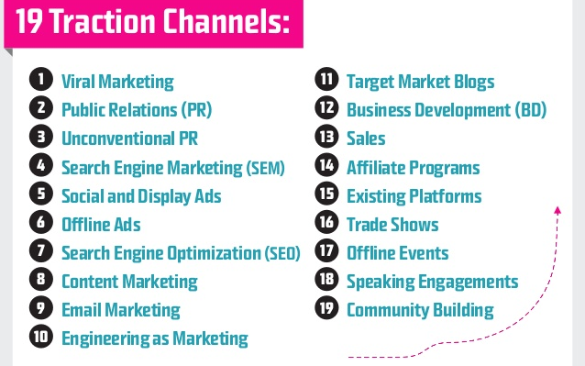
Communication/Traction Channels
Figuring out what communication channels to use to promote your product is an important aspect of value delivery.
Here are 19 non-mass-media channels you can use to gain traction.
Notes:
As this graphic shows, there are a lot of different channels through which you can seek to reach and acquire customers while attempting to gain traction for your new product. Ultimately, picking the most promising channel(s) and conducting experiments as part of the evidence-based entrepreneurship process will help you to determine the most cost-effective way(s) to make customers aware of your product and entice them to purchase it.

Slide 5
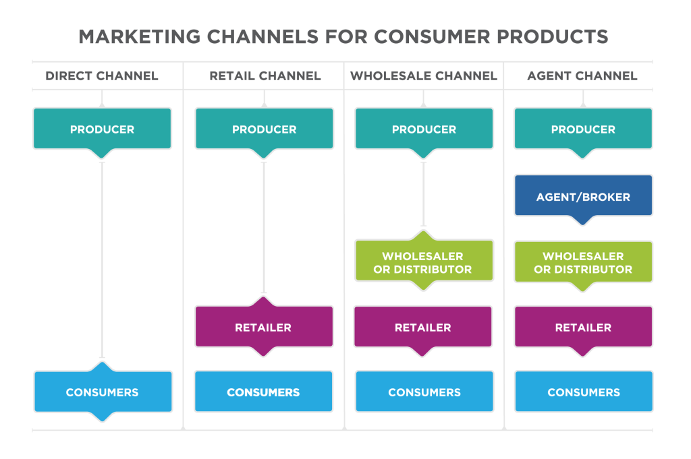
Distribution Channels
Many general types:
Business to consumer (B2C)
Business to business (B2B)
Consumer to consumer (C2C or peer to peer)
Notes:
To go along with your communication/traction channel experimentation, you’ll also need to determine how the product will get into the hands of your customers. This is where distribution channels come in. There are many different ways for entrepreneurs to distribute their products to customers. Developing and testing your guess for how you can get your new good or service to your customers is an important component of your model for value delivery.

Slide 6
Capturing Value
Setting the price
Relationship between price and profitability
Capturing other forms of value
Notes:
In addition to testing and refining your guesses for how to deliver value, entrepreneurs also need to validate their guesses for how they’ll capture value from customers. Perhaps the most important decision that’s involved in capturing value is setting the selling price. However, there are other forms of value capture that should also be considered.

Slide 7
Setting the Price
The selling price is the primary mechanism for capturing value from a new idea
There are many different ways to set the price of your product – for example, markup pricing or matching the competition’s prices
Setting prices based on perceived value (rather than costs) is typically the best, but also the most challenging method
Using this method involves continuously experimenting with different prices to map the associated impact on demand
Assuming your product offers truly unique value, the use of value-based pricing should maximize your unit margin and provide the best chance for the creation of an economically viable venture

Slide 8
Relationship Between Price and Profitability
The selling price determine the unit margin, or the amount of money you make from selling a product that can be used to cover your fixed costs.
For example, if you make a t-shirt for $8 and sell it for $12 then you would make just $4 per shirt (price – unit cost) that could be used to cover fixed costs like your business license, t-shirt making equipment or salaries.
However, if your shirt offered unique value you might be able to charge $25, which would leave you with $17 per shirt.
It’s worth noting that having the power to increase price by just 1% without affecting demand will lead to a 5-10% increase in bottom line profitability for most companies.
Notes:
Prices and pricing power largely determine the profitability of a company.
They also help to determine your margin for error. Consider a business wherein you make t-shirts. If there is nothing extraordinary about your shirts then you are likey to make a small margin of a few dollars on each shirt that could be used to cover your fixed costs. In contrast, if your shirt was exceptional and in high demand, you might be able to make a much larger margin, thereby giving yourself more room for error and more room for profit.
As most companies in the S&P 500 product bottom line profit of 10-15%, a company that creates and delivers sufficient value to increase their prices by just 1% without decreasing demand will actually realize a 5-10% increase in bottom line profitability, because the entire 1% would go straight to the bottom line without adding costs (and 1%/10% = 10 percent increase in profitability; 1/15 = 6.67 percent increase in profitability).

Slide 9
Capturing Other Forms of Value
Selling price is not the only form of value that you can capture
Other forms might include:
Customer referrals and word of mouth
Viewing advertisements
Collecting valuable (and monetizable) customer data
Serving as beta testers
Testimonials
Customer generated content
Key point: Entrepreneurs should seek to optimize the TOTAL value that they are able to capture from the selling price AND other sources of value
Notes:
When we think about capturing value from new ideas, it is easy to focus on the selling price. But price is just one form for value that can be captured in exchange for a good or service. Other forms of value that the entrepreneur can capture from a customer might include:
Customer referrals and word of mouth
Viewing advertisements
Collecting valuable (and monetizable) customer data
Serving as beta testers
Testimonials
Customer generated content

Slide 10
Transitioning from Search to Execution
As with customer discovery and solution testing, which are useful for determining whether your new idea has the potential to create unique value, the process of determining whether you can develop and economically viable model for delivering and capture value involves formulating your best guesses and then testing your guesses
Once you have validated a viable model for creating, delivering and capturing value from a new idea, then it’s time to focus on attracting early adopters and begin to transition from search to execution
Most new ideas don’t (or at least shouldn’t) make it to this stage in the evidence-based entrepreneurship process
Those that do should continue to experiment and utilize evidence to guide their decision making

