Slide 1
Customer Discovery
Notes:
As you will recall, entrepreneurship can be defined as pursuing the creation, delivery and capture of value from new ideas, so the topic of creating value is central to the practice of entrepreneurship.

Slide 2
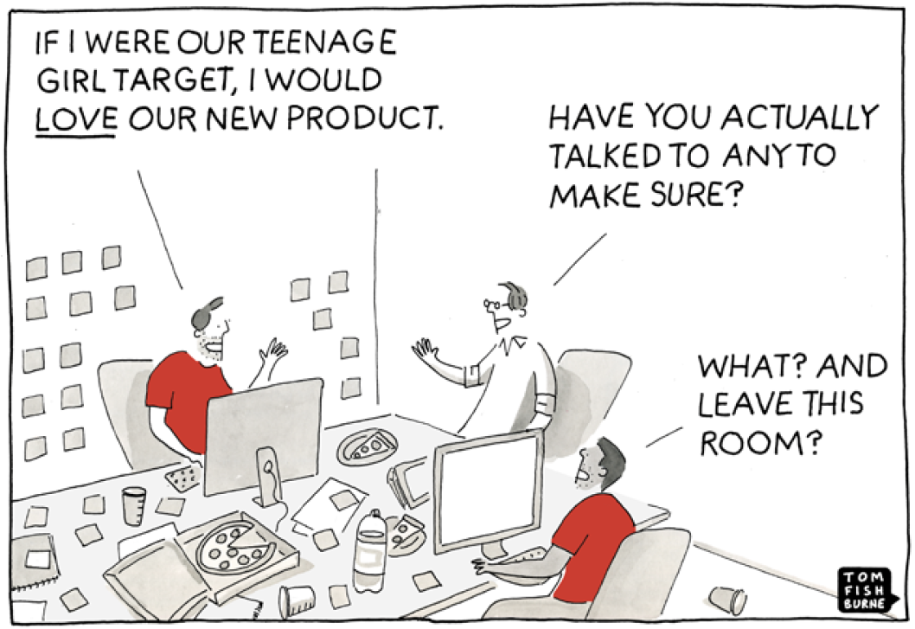
Notes:
As silly as the cartoon may seem, many entrepreneurs rely on their assumptions (or guesses) about what their customers will want instead of testing and confirming their interests before risking a lot of time, money and other resources. The whole point of evidence-based entrepreneurship is to avoid making this mistake.

Slide 3
Customer Discovery
Customer discovery involves beginning to systematically de-risk a new venture concept by gathering evidence to turn guesses about value creation into facts
For example, initial responses to value creation questions are usually guesses based on the founders’ beliefs, rather than customer data
What problem are your solving? [guess]
Who has the problem? [guess]
How are people solving the problem today? [guess]
Why will customers prefer your solution? [guess]
A process akin to the scientific method can be used to turn these guesses into facts
Notes:
Evidence-based entrepreneurship can be thought of as building a business like a scientist. That is – making your best guesses about how things will work and then conducting tests to confirm (or validate) that you are right.

Slide 4
Customer Discovery Process
Set vision (your idea & its many associated guesses)
Translate vision into falsifiable hypotheses
Specify tests
Prioritize tests
Run tests & learn
Persevere, pivot, perish?
Continue searching by repeating steps #1-6 as needed
Notes:
The evidence-based entrepreneurship process involves a series of oft-repeated steps.
This is sometimes referred to as a build-measure-learn loop.

Slide 5
Tips for Customer Discovery
Test riskiest guesses first by turning them into falsifiable hypotheses
In most cases, the riskiest guesses relate to value creation (because if no cares about the problem then they won’t care about the solution)
Customer discovery interviews are the primary method for testing guesses related to value creation

Slide 6
What Customer Discovery Interviews ARE
Asking people to share their experiences in the problem domain
Actively assessing an initial vision (and value creation hypothesis)
Engaging in interactive dialog with prospective customers
Looking for evidence to confirm or deny your guesses
Notes:
It is VERY IMPORTANT to understand what customer discovery is all about BECAUSE IT IS NOT PITCHING YOUR IDEA. Rather, it is about trying to really understand customers and their problems so that you can create compelling solutions that deliver unique value.

Slide 7
What Customer Discovery Interviews are NOT
Asking people to design your product for you
Abdicating your vision
Asking customers to complete survey or participate in focus groups
Pitching your product to prospective customers
Notes:
Again, do not use interviews as an opportunity to pitch. Rather, use them as an opportunity to LISTEN!

Slide 8
Turning Guesses into Hypotheses
An important step in looking for clues is to turn your guesses into falsifiable hypotheses – i.e., statements that can be demonstrated as valid or invalid based on evidence
Guess: University students struggle to know what classes they need to take to fulfill their graduation requirements
Falsifiable hypothesis: 60% of University students will rank frustration with knowing what classes they need to take as a “very painful” part of the academic advising process
Notes:
This is an important slide to understand and spend some time on. To effectively utilize customer discover, students need to be able to translate their guesses bout how they will create value into a falsifiable statement.
It is suggested that you spend time before class looking at a few actual examples of your students new venture ideas and their value creation hypotheses to consider what falsifiable statement(s) you could make out of them to ensure that students really understand this part of the evidence-based entrepreneurship process.

Slide 9
What are Your Riskiest Guesses and How Will You Gather Evidence to De-Risk Them?
Take about 10 minutes to discuss what you see as the biggest risks to the validity of your value creation hypothesis.
Then think about how you’d de-risk your guesses?
What is a falsifiable hypothesis that you can test to assess the validity of your guess about the problem and who has the problem?
What kinds of questions would you ask?
Who would you ask?

Slide 10
Customer Interviewing 101: Problem Interviews
Conducted to understand and test hypotheses about customers and their problems/pain
Helpful for identifying early adopters and learning how problem(s) currently solved
Face-to-face STRONGLY preferred; skype second; phone third
Should be driven by an interview script
Notes:
Most students will resist talking face to face with people about their experiences, but it is VITAL to learning. DO NOT allow them to simply do web surveys or email prospective customers as those methods lose almost all of the richness and value of customer discovery interviewing.

Slide 11
Develop an Interview Script
Welcome (2 minutes)
Customer characteristics questions (2 minutes)
Tell a brief story to set problem context (2 minutes)
Explore customers’ experiences in the problem domain (5 minutes)
Customer-problem fit (5 minutes)
Explore customer’s worldview (10 minutes)
Wrap up with the hook and ask (2 minutes)
Document results (5 minutes)
Notes:
The script should be viewed as a heuristic or rule of thumb to follow, not as a rigid survey wherein all questions must be asked and answered. The best way to think of it is as a plan for a structured, but free-flowing conversation with a prospective customer.

Slide 12
Welcome
GOAL: Establish rapport, disarm politeness
“Thank you…”
“We are working on…” (limit this to 2 sentences)
“But before we get too far ahead of ourselves, we want to talk to you to see if there are any real problems here worth solving.”
“The way the interview will work is I’ll describe something to you and ask for your comments.”
“Please don’t worry about hurting our feelings, we want your honest opinions.”
“Also, I’d like to stress that we don’t have a finished product yet, so our objective is to learn from you – not to sell or pitch you.”
“Sound good?”
Notes:
This slide and the next several provide sample language that could be used to accomplish each of the micro-goals associated with the various components of the students’ customer discovery scripts.
It is not necessary for students to rigidly adhere to this language, as they will need to use their own words to feel comfortable.

Slide 13
Customer Characteristics Questions
GOAL: Qualify interviewee as a member of the target segment
“Before we talk about problems, we’d like to ask you a few question about <you, your business, your occupation, your life as a college student, etc>”
Ask questions that relate to your guess about who has the problem to qualify the person you are speaking with as a member of your target market
If they do not fit your segment definition, that’s okay, but you will want to disqualify them from your hypothesis test

Slide 14
Tell a Story to Set the Problem Context
GOAL: Provide a frame of reference; get the interviewee to start thinking about the problem context.
“Great. Thanks. So now let me tell you about the problems we’re tackling.”
“We think a lot of <fill in assumptions corresponding to your customer hypothesis> experience <fill in with 1-3 general guesses corresponding to your problem hypothesis>”
“But we want to make sure we are on the right track before we commit to figuring out a solution, so we’re very interested in your thoughts.”

Slide 15
Explore Customers’ Experiences
GOAL: Uncover major pains, dissatisfactions related to the problem context
Ask broad questions relating to the customers’ experiences within the problem domain
“Tell me about <your experiences with…brief description of the problem domain>”
“Describe your most recent experience with <the problem domain>”.

Slide 16
Customer-Problem Fit
GOAL: Test your problem hypotheses
Hand interviewee a piece of paper with each problem guess listed as a separate item; include problems mentioned in the exploration of customers’ experiences
“So here are some problems we think <customer segment guesses> have. What are your thoughts?”
“Which of these resonate with you?”
“Tell me more about…”
“How would you rank these problems – from biggest to smallest (for you)?”
“How critical is <problem ranked #1> to <you, your business, your life as…>?”
“How important is <problem ranked #2, 3, etc.> to <you, your business, your life as…>?”
Notes:
Handing the interviewee a piece of paper is just one possible way to (a) explore the nature of customer problems and (b) estimate the magnitude of the pain caused by the problems. You could also just state each one individually and ask interviewees for their thoughts. “We’ve heard from others that [problem] is an issue. Does that resonate with you?”

Slide 17
Explore the Customer’s Worldview
GOAL: Learn about depth of problem, existing solutions used, and decision criteria for choosing a solution
Go through each highly ranked problem in turn, including any added by the interviewee. Ask them how they address it today. Then sit back and listen.
“You mentioned <problem #1> was <rating of importance> to <you, your business, your life as…>. What have you been doing to address it?”
Follow-ups:
“That’s interesting, tell me more about…”
“What have you tried in the past?”
“How did you decide to try XXXX as a solution to your problem?”
“What would be the most important benefit you’d want to see in a solution to the problem?”
Note and assess body language

Slide 18
Wrapping Up
GOAL: Keep interviewee in your prospect pool and generate referrals
“As I mentioned at the start, we are <fill in what you are trying to accomplish> but we do not have a finished product. Our current concept is best described as ________ (no more than a couple sentences here)”
“Based on what we talked about today, would you be willing to see the product when we have something ready?”
“Also, we are looking to interview other helpful people like yourself. Do you know any other <customer hypothesis> who might be willing to speak with us?”
Notes:
Again, customer discovery interviews are not about pitching. However, if you are really onto a pain, you want to keep open the possibility of coming back later for a pitch. You’ll also get a good sense of whether the customer things you are on to an important problem if they refer you to others.

Slide 19
Document Results
Goal: Capture nuance in meaning for systematic review
Document results immediately after the interview while they are still in your mind
It may help to use a template to record responses pertinent to your hypotheses
Notes:
Documentation should include writing down interviewee comments in a manner that is as close to verbatim recall as possible. Be sure to include both supporting insights and comments that go against your guesses/hypotheses.

Slide 20
A Pitch is Not Included
Problem interviews should reveal almost nothing about your planned solution (ESPECIALLY IF YOU STILL NEED TO FILE A PATENT).
This is NOT a pitch and ask “what do you think” moment!!!

Slide 21
A Survey is NOT an Interview!
Interviews allow open-ended exploration.
Get to the why (and not just the what)
Follow up on interesting responses
Interviews provide an opportunity to seek clarification.
Interviews capture meaning conveyed through nonverbal.
Notes:
Again, many students will want to just administer a survey to prospective customers. Doing so will eliminate the possibility of followups and “why?” type questions, which are CRITICAL for gaining insight into customers experiences/problems.

Slide 22
General Guidelines for Customer Interviews
The script is a guide; get comfortable with it & then try to be consistent with it for an entire set of interviews
Conduct interviews with at least one other team member (they can write notes and bring discussion back to key topics, as needed)
Document results immediately
Expect that many of your assumptions and hypotheses will be invalidated (this is actually good news, as it will prevent you from wasting your time!!!)

Slide 23
General Guidelines (cont.)
Work to their schedule; neutral location
Ask for sufficient time
Disarm “politeness” training
Get psyched to hear things you don’t want to hear
Ask open-ended questions
LISTEN, don’t talk

Slide 24
General Guidelines (cont.)
Try to gain insights into their behavior, not just perceptions
Don’t ask leading questions
Follow your nose and drill down (“That’s interesting, tell me more about…”)
Parrot back to confirm and elicit elaboration (“Let me make sure I understand. You said…”)
Don’t forget to say “thank you”!
Ask for introductions

Slide 25
Tips for Finding Customers to Interview
Emphasize value of their opinions, expertise and experience
Play the student card (if relevant)
Start with 1st degree contacts, but not close friends or relatives
Ask for introductions
Ask others to help with connecting with people in their networks
Cold calling/email/LinkedIn – try to find weak ties (affiliation with your school or church)
Find the moment of pain (when customers are experiencing the problem)
Try conferences and meet ups
Notes:
Finding interviewees can be difficult for students. However, it is imperative that they get comfortable trying to find people to talk to. If they push back, you can tell them that if they can’t find people to interview now, how can they possibly expect to find people to sell to later.

Slide 26
Summary
Customer discovery is about searching for clues to confirm or invalidate your guesses
Interviews are the best way to test hypotheses about customers and their problems because they offer more flexibility and insight than other methods (they can also help to uncover promising business model pivots)

