Slide 1
Creativity & Design Thinking

Slide 2
Common Problem Solving Shortcomings
1. Don’t have an identified problem
2. Don’t know enough about the problem
3. Don’t know about the user/beneficiary
4. Don’t have a goal and/or ideal solution
5. Didn’t generate lots of ideas
6. Didn’t consider human element
7. Didn’t see other perspectives
8. Didn’t work with others
9. Didn’t try/pilot/prototype solution
10. Didn’t iterate – “thought I was done!”
Notes:
Many efforts to create, deliver and capture value from new ideas suffer from one or more of these common problem solving shortcomings.

Slide 3
Design Thinking Process
Understand
Imagine
Iterate
Notes:
We can overcome these common shortcoming by following a process – the design thinking process – as part of an overall evidence-based entrepreneurship process. While there are several variations of the designing thinking process, we are going to focus on one of the most straightforward, which specifies three basic steps: understand, imagine and iterate.

Slide 4
Understand
“A well-defined problem is a problem half-solved”
Start by mapping what we think we know about the problem
Who’s does the problem affect, how?
What are the direct & indirect consequences?
What are the root causes?
What has been done before to “solve the problem”?
What else do we know about the problem?
Notes:
The first step in the design thinking process is to gain a rich and full understanding of the problem we are trying to solve. To do this we need to map what we think we know about the problem, confirm what we actually know and then explore and fill in facets of the problem that are unknown.
Some questions you can ask yourself to map what you know about the problem include:
Who’s does the problem affect, how?
What are the direct & indirect consequences?
What are the root causes? Are there any moderating or contributing factors?
What has been done before to “solve the problem”?
What else do we know about the problem?

Slide 5
Activity #1: Problem Mapping
Take 10-15 minutes to map everything you know about your problem
Start with a statement that defines what the problem is and who has the problem
Then, explore:
What are the direct and indirect consequences?
What causes the problem? Are there any factors that make it worse?
What has been done before to solve the problem?
What else do we know about the problem?
Who can we talk to and how can we learn more about the problem?

Slide 6
What Next?
Do you feel like you know enough about the problem to develop the best possible solution?
How can we pressure test our understanding and figure out what we don’t know?
Notes:
Once we feel like we know everything possible about the problem we are trying to solve, it’s time to pressure test our understanding. Specifically, we need to share our understanding with domain experts, prospective customers/beneficiaries and others who can help to illuminate errors in our understanding while also helping us to become aware of our blindspots.

Slide 7
Activity #2: Gaining Input
Take 10-15 minutes to share your problem with another team
Start with your problem definition to set the context, then ask:
What are your initial thoughts about [the problem]?
Tell me about your experiences with [the problem]?
What do you see as causing [the problem]?
Does [the problem] matter? Why?
Who is impacted by [the problem], how?
Follow up on interesting responses to probe for deeper understanding (tell me more about that…)
Notes:
As an example of how talking to others can be helpful, you can have the students in your course share their problem with another student/team.

Slide 8
Problem Understanding
How did speaking to someone else enrich your understanding of the problem?
In general, we want to test and develop our understanding through interaction and observation with beneficiaries, customers, domain experts
End when you stop gaining new insights on the problem
Notes:
One of the biggest risks in entrepreneurship is spending too little time falling in love with an important problem and really becoming THE expert on the problem before trying to develop a unique solution. Most students want to skip the problem understanding step and move right to generating ideas, but understanding is critical.

Slide 9
Activity #3: Problem Pitches
Who feels like they understand enough about their problem to pitch it to the group?
No more than 90 seconds
Notes:
If you really understand your problem, then you should be able to share it with people in a way that will make them care about it. If you want to see where your students are in terms of the development of a rich understanding of the problem, have them pitch just their problem to the class.
One thing you will likely hear in their pitches is solution creep. In other words, you can expect that the allure of ideas/solutions is so strong that students who are asked to “talk about the problem you want to solve” will often skip past the problem to share their solution instead. When this occurs it is important to point out that they are presenting a solution, not explaining the problem that the solution is meant to solve.

Slide 10
Imagining Solutions
Once the problem is defined, use divergent thinking to imagine possible solutions
Brainstorming
Reverse brainstorming
Brain writing
Scamper
Many others…
Notes:
After students truly possess a rich understanding of the problem they are trying to solve, it is time to move to the imagine phase of the design thinking process. During this phase, the goal is divergence – imagining as many different, creative solutions as possible without worrying about their feasibility or practical constraints. Those enter into the process later, when we try to converge around the most promising solution to test and iterate.

Slide 11
Divergent Thinking!
Notes:
Again, the goal of divergent thinking is to come up with the broadest, most creative set of possible solutions. By so doing, we can overcome the limitations of any preconceptions or hidden assumptions to ultimately develop the most compelling, value creating solutions possible.

Slide 12
Keys for Divergence
Start with a “how might we” question about your problem
Defer judgment
Go for quantity
Support the strange
Build off other ideas
Stay on topic
Notes:
There are many tips for divergent thinking. All focus on really opening your mind and avoiding judgment.

Slide 13
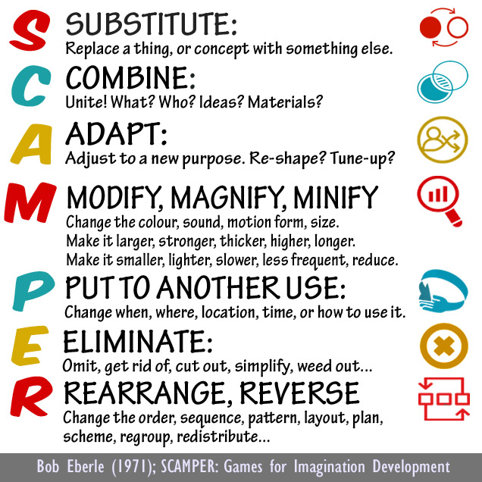
Activity #4: Imagine Solutions
Try using a variety of creativity techniques to imagine possible solutions to your problem, including:
Brainstorming
Brain writing
Reverse brainstorming
Notes:
Brainwriting – individual brainstorming that is done quietly; group members can share their ideas with each other at the end of a brainwriting session to benefit from interplay with others
Reverse brainstorming – trying to devise ways to make the problem worse
SCAMPER – How might we improve an existing solution (or modify one of our brainstormed solutions) by: substituting? combining? Adapting? Etc…

Slide 14
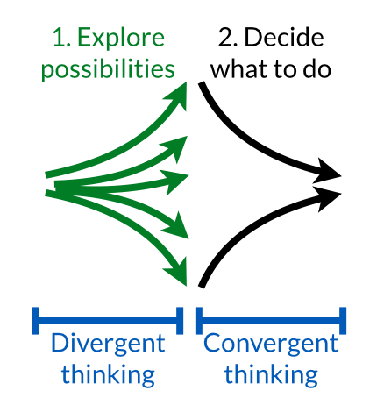
Convergent Thinking!
Notes:
Whereas divergent thinking is all about creating possibilities, convergent thinking is about trying to identify the most promising solution(s) for further consideration.

Slide 15
Convergence
Develop and apply solution criteria
Cost
Scope, magnitude of impact
Speed
Feasibility
Availability of partners
Potential for unintended consequences
Etc.
Choose what you think is the most promising solution
This solution will then be tested, iterated

Slide 16
Iterate
Once you have:
Developed a rich understanding of the problem,
Explored the full universe of potential solutions, and
Converged on the most promising solution(s), then its time to put your idea into action
Putting your idea into action involves:
Systematically gathering data to validate/invalidate specific aspects of your idea
Using data to guide decisions on whether to iterate, pivot or perish
Notes:
Once student have developed a rich understanding and gone through a divergence and convergence process, they should be well-positioned to consider how to put their ideas into action. The next module of the course will take a deep dive into how to do this.

Slide 17
Benefits of Using Design Thinking
1. Don’t HAVE an identified problem
2. Don’t KNOW enough about the problem
3. Don’t KNOW about the user
4. Don’t HAVE a goal and/or ideal solution
5. DIDn’t generate lots of ideas
6. DIDn’t consider human element
7. DIDn’t see other perspectives
8. DIDn’t work with others
9. DIDn’t try/pilot/prototype solution
10. DIDn’t iterate – “thought I was done!” gathered evidence to make it better.
Notes:
If you follow the design thinking process by: (1) understanding, (2) imagining and (3) iterating, then you can avoid the most common problem solving shortcomings.

