Slide 1
Business Models

Slide 2
What is a Business Model?
Business model: a description of how your company creates, delivers & captures value
Notes:
Before diving into the lean startup process, it is also useful to highlight a few key definitions.
The term business model refers to the combination of product, market, and strategic elements that describe how your company creates, delivers & captures value
Customer development refers to the process of quickly testing business model hypotheses and iterating based on learning and empirical evidence
MVP or minimum viable product is the smallest or simplest thing you can build that delivers customer value
And a pivot is a change in one or more of the components of the business model as a result of validated learning

Slide 3
A Business Model Canvas
A type of tool that allows you to deconstruct your rational for creating, delivering and capturing value into its constituent components
Useful for tracking guesses/hypotheses and what is known vs. unknown in the model you envision
There are several variations of canvases; the best one to use will vary
The lean canvas is often a good fit for startups
Osterwalder’s business model canvas is great for established companies
A social impact canvas works well for social ventures

Slide 4
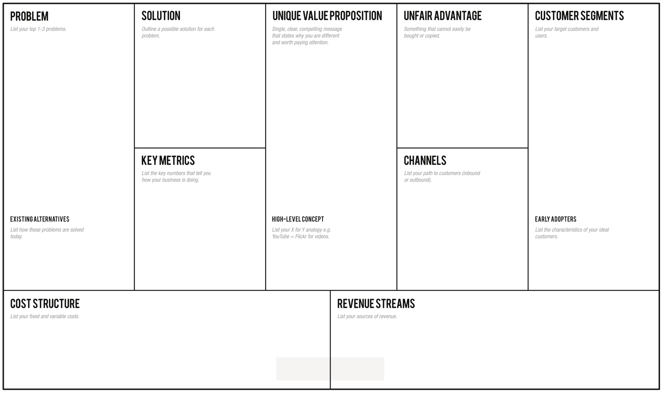
Lean Canvas (from Ash Maurya)
Notes:
The version shown on this slide was developed by Ash Maurya and is often referred to as the lean canvas. I like the lean canvas for getting started with an idea because it emphasizes the customer, problem, and solution – the three basic building blocks of an idea. The Lean Canvas also brings in the notion of competition by highlighting the business’s unique value proposition and unfair advantage.
The notion of being unique vis-à-vis the competition is particularly important for startups because they often have few resources to devote to marketing communications. Therefore, they need to offer something unique and desirable so that their message will resonate with a high percentage of the early customers it reaches.
The notion of an unfair advantage is also important for startups because prospective investors, employees, and other stakeholders need to feel confident that others will face at least some significant barriers in any attempt to replicate the business model.
We are going to watch a 20 minute video on capturing your business model to explain how to fill in and use the canvas.

Slide 5
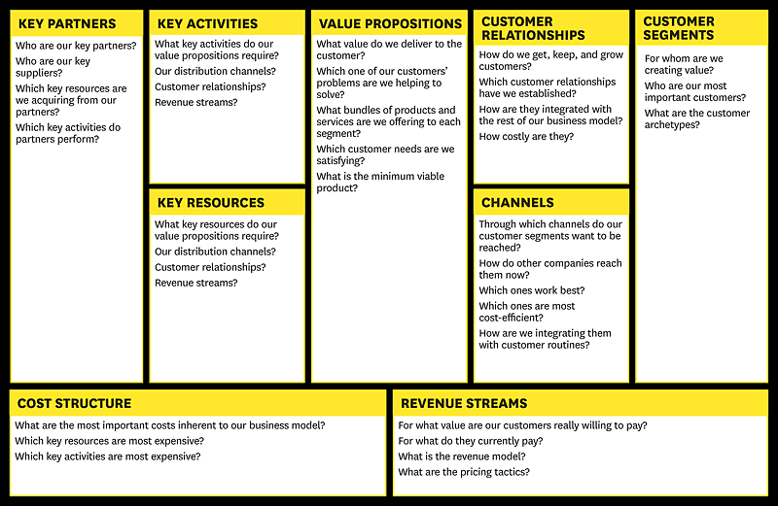
The Business Model Canvas (Alex Osterwalder)
Notes:
The most widely utilized version of a business model canvas was developed by Alexander Osterwalder and Yves Pigneur in their book “Business Model Generation,” which is a must read for anyone involved in developing and executing business strategy. The Osterwalder canvas is sometimes referred to as THE business model canvas, but I prefer to think of the canvas as a general set of tools for mapping the components of a business model.
I find “The Business Model Canvas” most useful for existing businesses. It was built as a strategic management tool and co-opted for use with startups. As a result, it fails to include notions that are critical to startup success – problem being solved, solution and a direct allusion to the competition – all things that startups needs to be laser-focused on.

Slide 6
Two-Sided Market Canvas
Notes:
It is possible to represent a two-sided market on a single canvas; but this adaptation makes it even clearer.

Slide 7
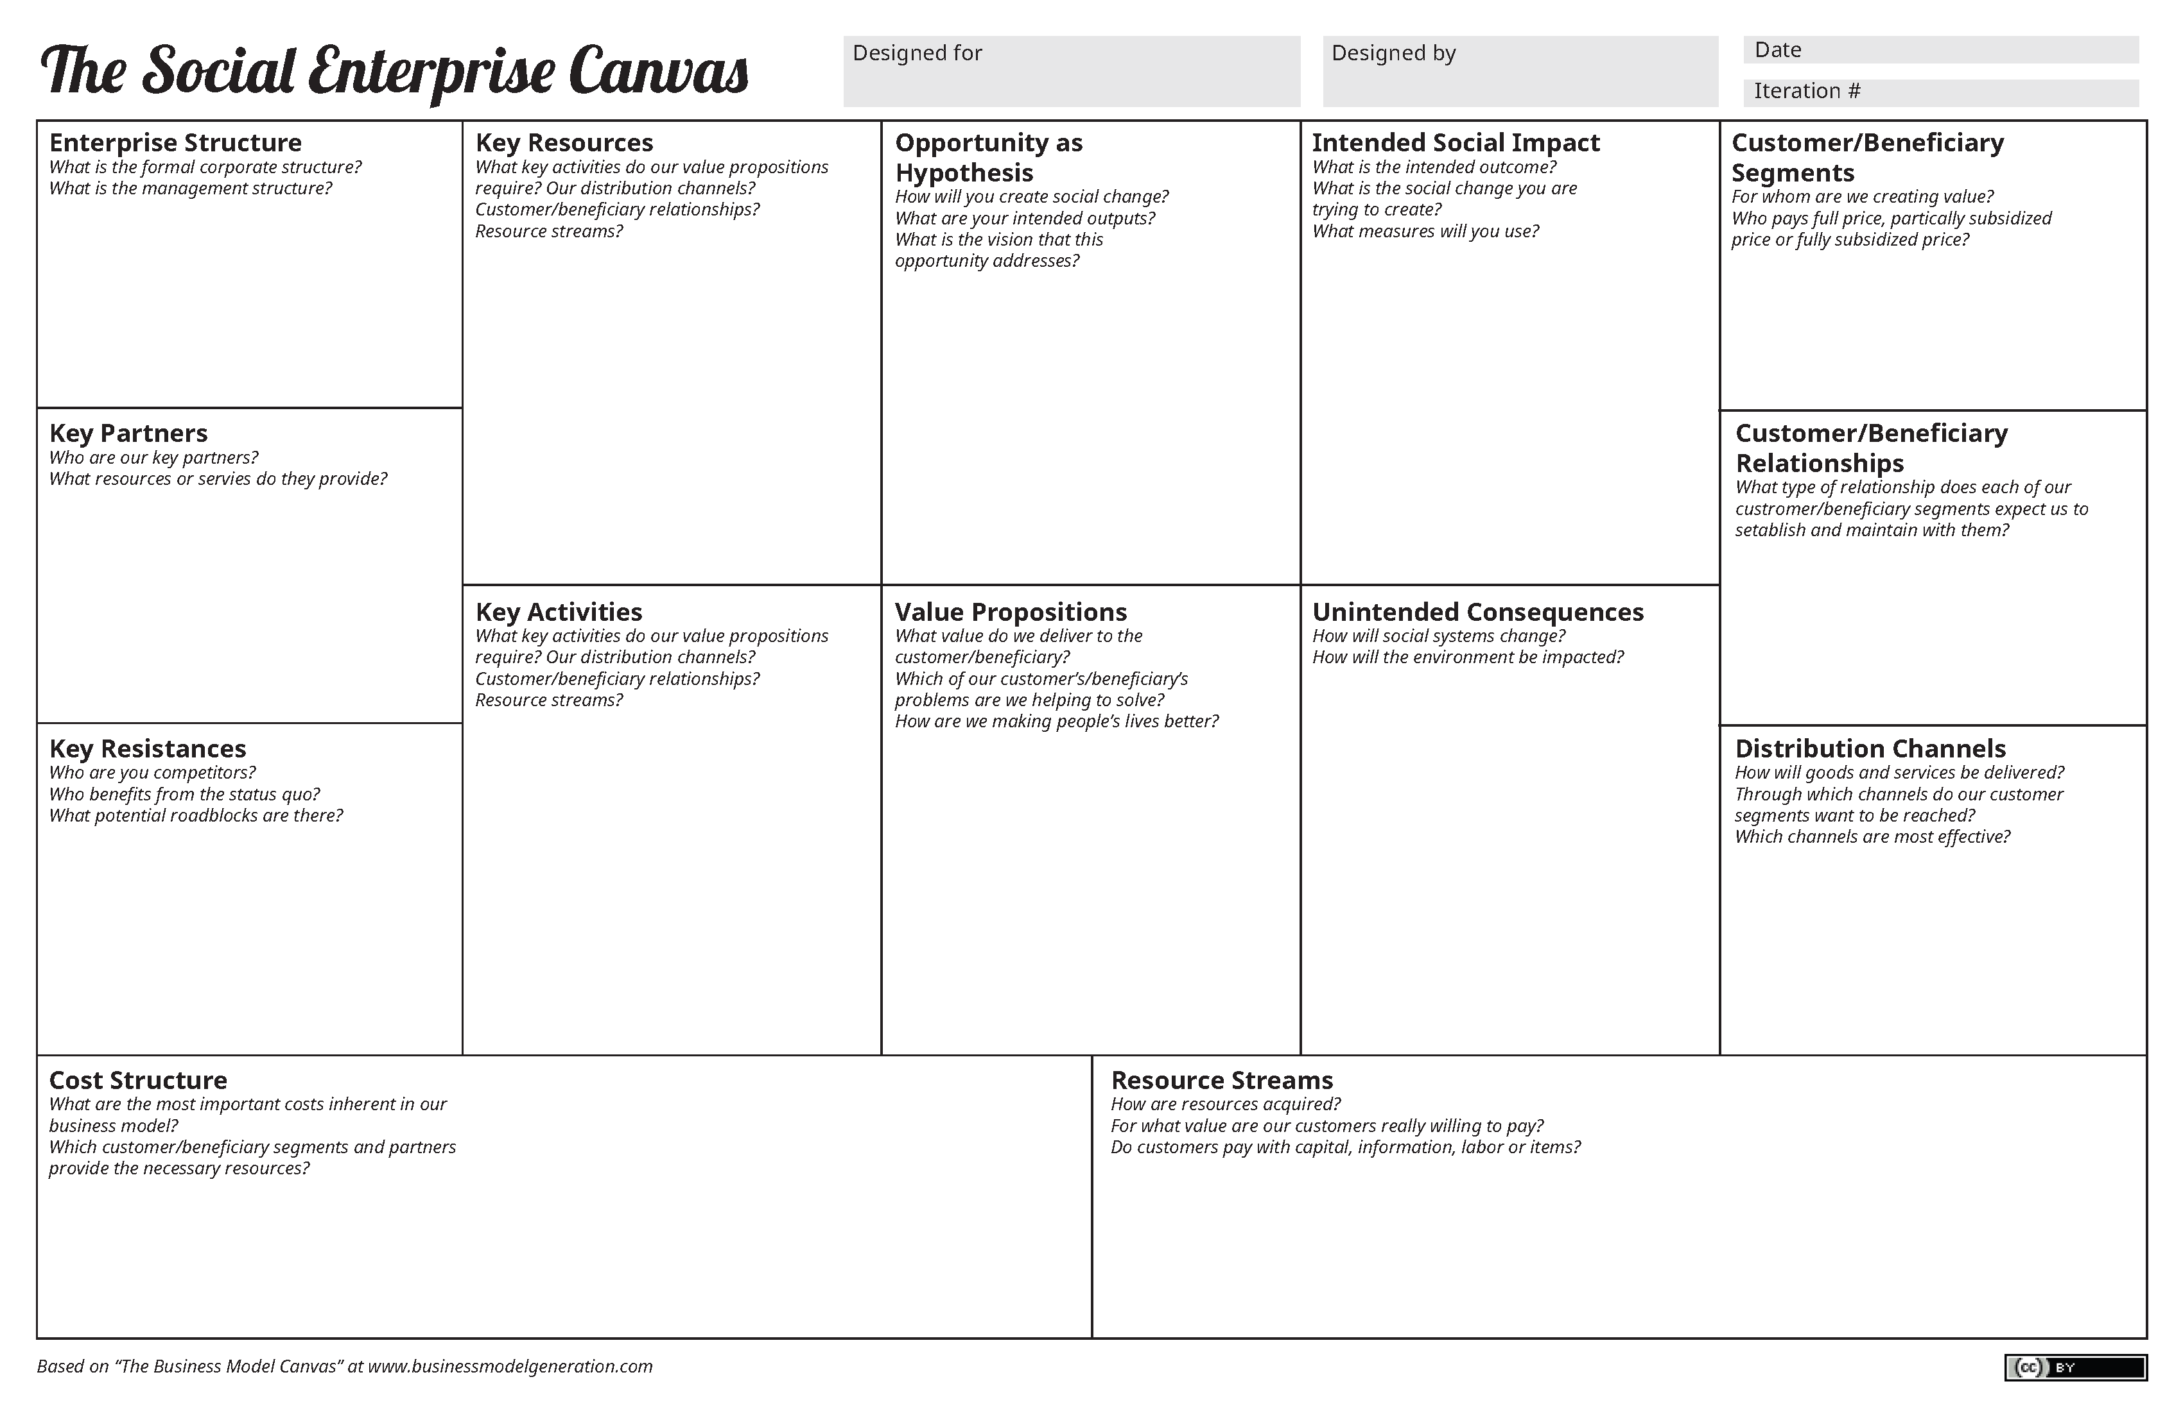
Social Enterprise Canvas

Slide 8
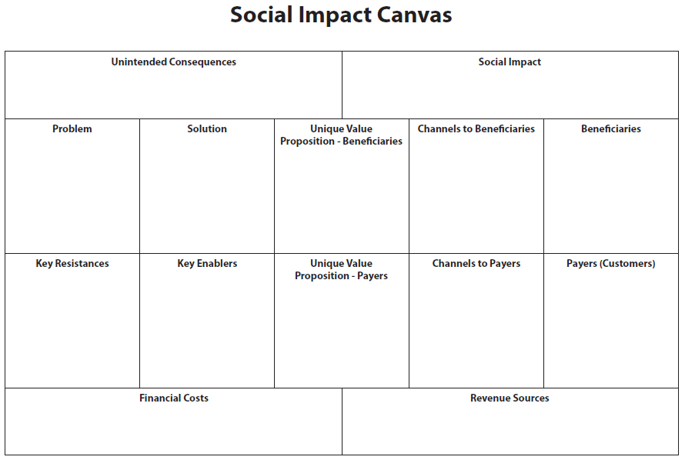
Horn Social Impact Canvas

Slide 9
Choosing a Canvas
The best canvas to use is the one that contains the key components of your rationale for creating, delivering and capturing value
The default for the program is the lean canvas
If you can’t find one that fits well, you can always create your own to ensure that you are able to map your model and track your efforts to de-risk it by gathering evidence

Slide 10
Activity
To gain experience in using a business model canvas tool, try to map the components of the business model for a company that you are familiar with (e.g., Apple)
How does Apple create, deliver and capture value?

Slide 11
General Models
Once you become familiar with business models you will begin to see patterns and understand the key factors needed to succeed with different types of models
Examples of general (traditional) models include: manufacturer, retailer, franchise, wholesaler/distributor, and direct sales
For a more comprehensive list of models, check out: https://fourweekmba.com/what-is-a-business-model/

